Slide 1
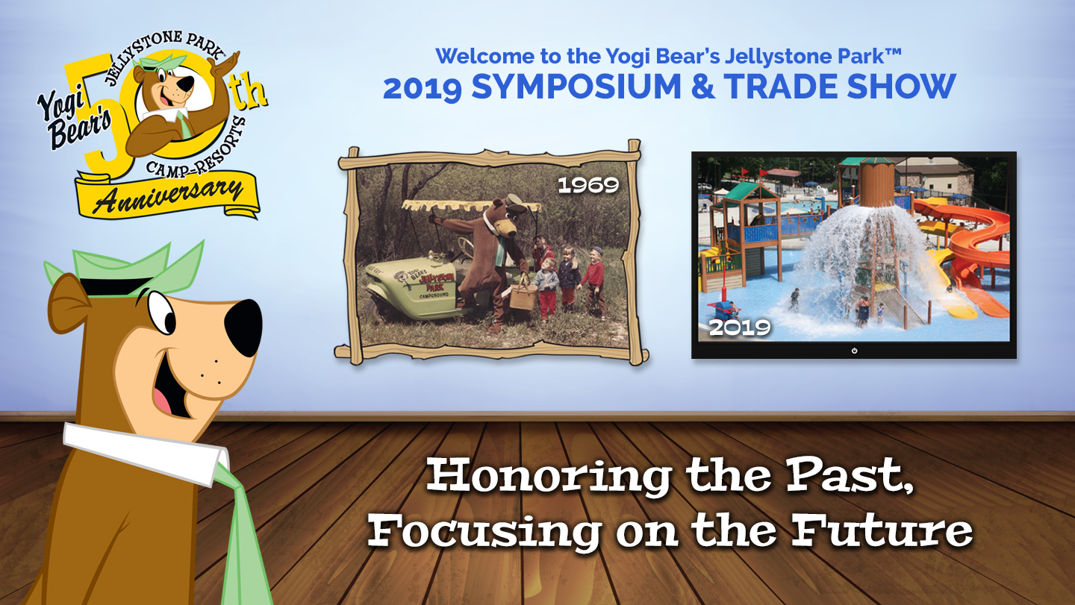
YOGI BEAR and all related characters and elements © & ™ Hanna-Barbera. (s19)

Slide 2
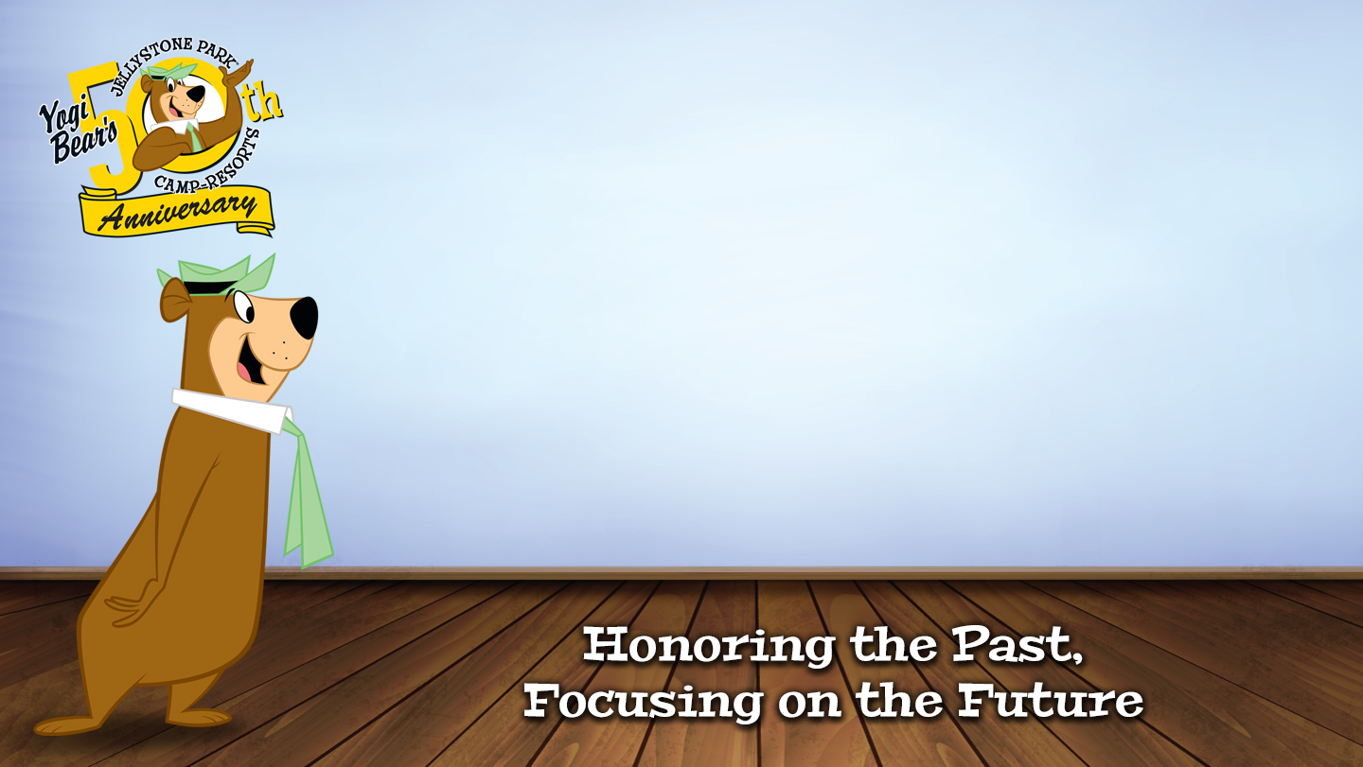
Campground Construction Projects and Construction Financing: Opportunities to take Advantage of and Pitfalls to be Avoided
By: Randy Isaacson
Campground Loan Coordinator
CCF Bank (purchased United Bank)

Slide 3
Disclaimer
The opinions expressed in this presentation and on the following slides are solely those of the presenter and not necessarily those of CCF Bank.
This presentation is to stimulate discussion. Ultimately, it is the responsibility of the attendees to draw their own conclusions and make their own decisions.

Slide 4
Randy Isaacson BIO
Randy Isaacson is a Campground Lending Coordinator for CCF Bank (formerly for United Bank which was purchased by CCF Bank) that specializes in National RV Park/Campground Financing. While a Lender for 37 years, he started this financing program 20 years ago which has originated approximately $150 million of RV Park/Campground Loans in 23 states. The CCF Bank office south of Milwaukee is exclusively dedicated to RV Park/Campground Financing.
Randy has made previous presentations for Jellystone Symposiums and Spring Meetings, ARVC and WACO. He has visited over 450 campgrounds throughout the US and has made over 700 field visits overall. He has attended TACO, IAPPA and has been a member of 20 Group 2 for about 15 years. His wife Theresa was on the Jellystone System Yogi Advisory Committee. His daughters Bridget Bender and Marley Behnke have been on various committees and speakers for Jellystone.
Randy’s family camped themselves for 23 years before becoming involved in ownership and management in Yogi Bear’s Jellystone Park Camp-Resort in Caledonia.
In 2014 the Jellystone System named Jellystone Park “Camp Resort of the Year”. In addition to the campground, thousands of people drive through the Wisconsin Christmas Carnival of Lights drive through Christmas light show with as many as 1,000 cars in one night.
Randy’s wife Theresa, daughters Bridget Bender, Rachel Heinson, and Marley Behnke and all son-in-laws have been involved in the management or operation of the Jellystone Caledonia park at one time or another. They have helped increase the revenue to over 8X in 2019 what it was their first year. With 12 grandchildren of whom 10 are ages 9 and under, childcare for park management has become an interesting challenge depending on what families were involved working in the park.
In 2016, negotiations began on purchasing an adjacent 150 acre parcel of land which was completed in 2018. In 2019 a major expansion of: the purchase of 100 sites, 50 park models, 3.2 acre swim pond with Wibit, playground, pavilion, a bathhouse/concession area/boutique store/banquet hall was completed, “Yogi’s Cave” and more golf carts were completed.
Randy’s wife Theresa, daughters Bridget Bender, Rachel Heinson, and Marley Behnke purchased an RV Park in Rockport, Texas in December 2015. Theresa is the Managing Member that provides oversight to onsite managers at the park. This park took a direct hit from Hurricane Harvey in 2017.
Randy grew up on a family farm in Wisconsin. Up until 2013, he was an EMT and for 16 years was the Service Director for a municipal ambulance service. He is a graduate of LeTourneau University in Longview, Texas with a Bachelor of Science Degree in Business Administration.

Slide 5
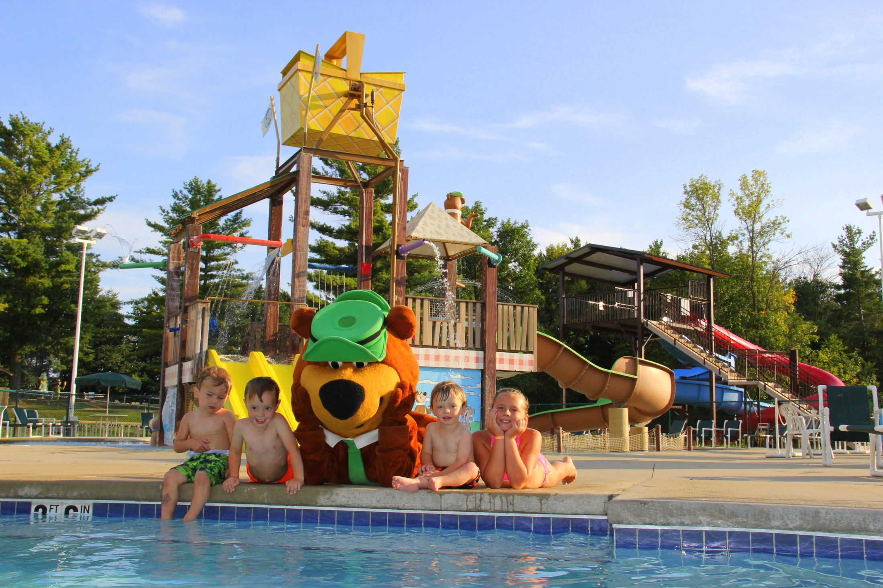
Randy and his family own a Jellystone Park on 6.5 miles from the office for the past 10 years. Randy’s wife Theresa, 3 daughters and a son-in-law manage the operation which has 282 sites including 25 cabins. On busy weekends in the summer there may be 1,100-1,500 people in the park.
Theresa is on the YAC (Yogi Advisory Committee for the Jellystone system and his daughters are regular contributors to Jellystone meetings. (4 of 9 Grandkids shown below with Yogi)
In 2014, this park was honored to receive the Camp Resort of the Year in the Jellystone System.
Randy and his family own a Jellystone Park on 6.5 miles from the office for the past 15 years. Randy’s wife Theresa, 3* daughters and a son-in-law manage the operation which had 282 sites including 25 cabins. On busy weekends in the summer there might be 1,100-1,500 people in the park.
Theresa was on the YAC (Yogi Advisory Committee for the Jellystone system and his daughters are regular contributors to Jellystone meetings. (4 of 12 Grandkids shown below with Yogi)
*2 since 2018, Marley is with LSI

Slide 6
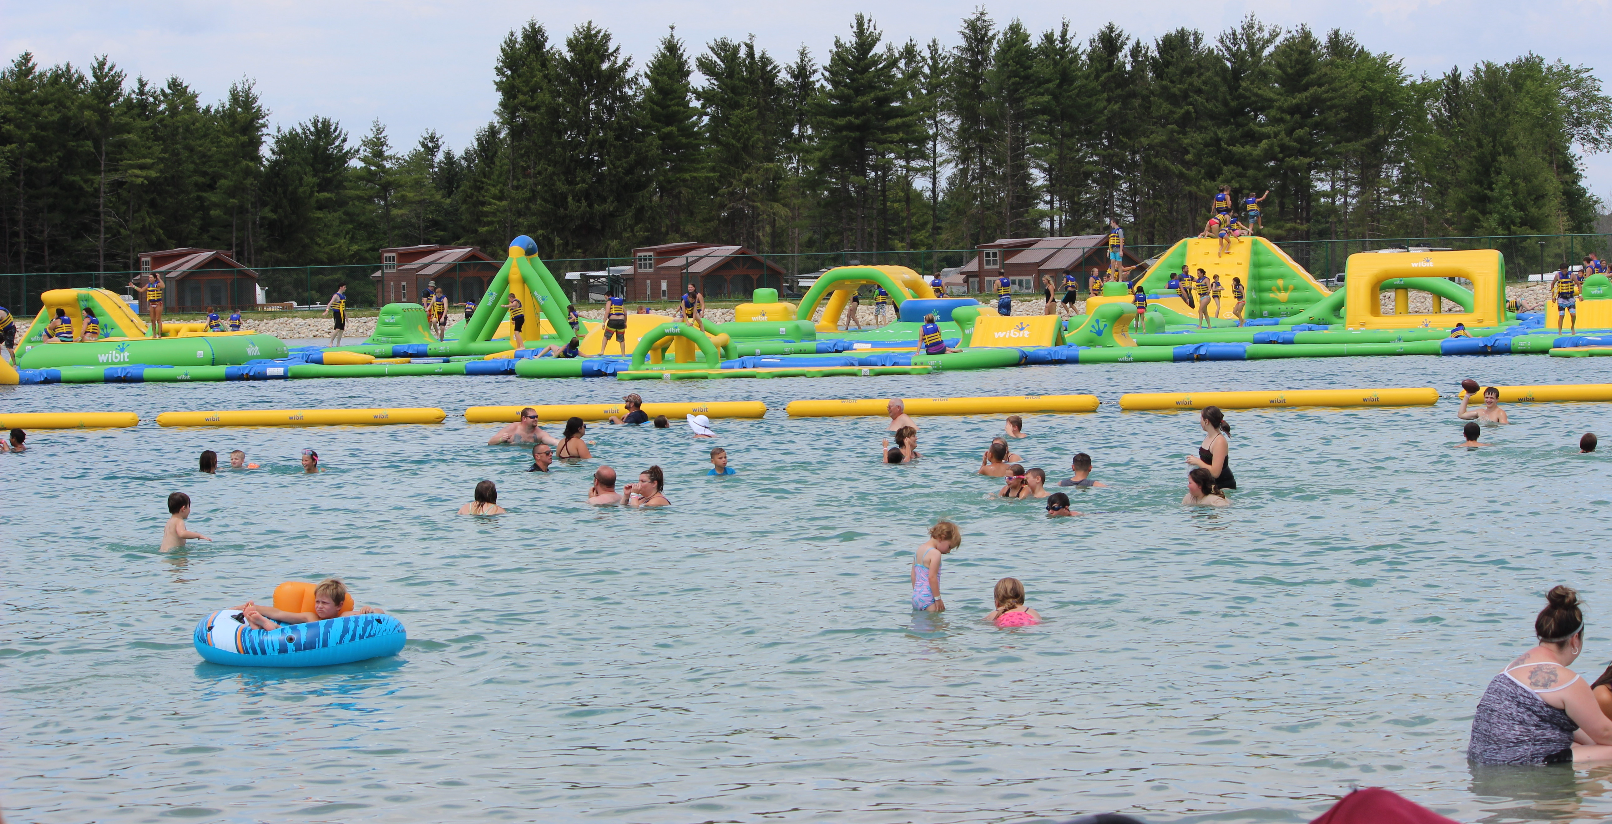
Expansion 2018-2019

Slide 7
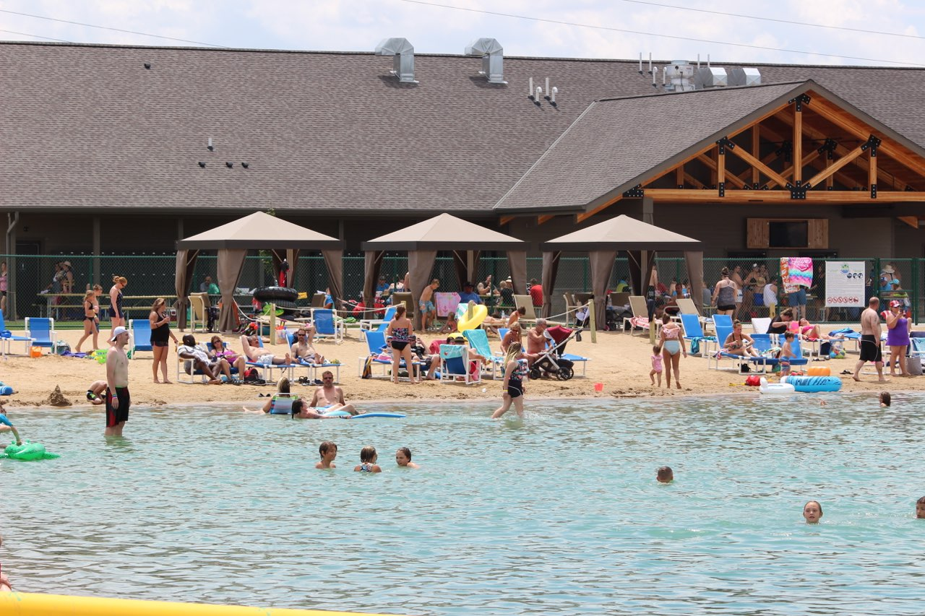

Slide 8
How it all started
It all began on an annual family vacation at Jellystone Park in Warrens, WI.
At Midnight outside the comfort station, Friday, July 9, 1999 Randy Isaacson had his sales hat on and struck up a conversation with the son-in-law of the owner of the Warrens Jellystone.
On Saturday, July 10, 1999, he met with the owner and discovered that the franchise was looking for a banker that would take the time to understand the industry so that an applicant would not have to first educate the bank about the industry before the loan application.

Slide 9
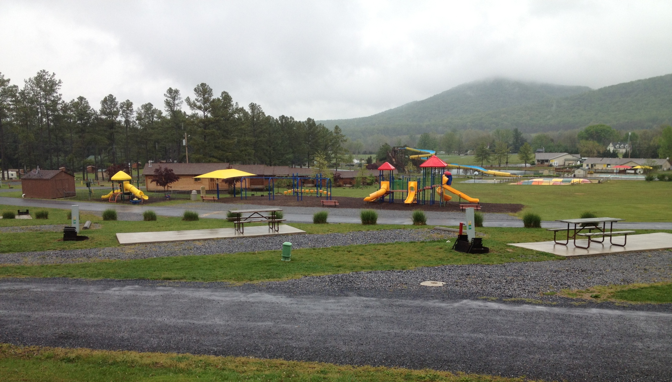
First Campground Loan:
Jellystone Park, Virginia
Field Visit: September 1999
Closed: December 1999
Financial Results:
1999 2000 2000 2013
Actual Projected Actual Actual
Gross Revenue $754,474 $961,411 $944,403 (2%) $2,743,087
EBITDA $185,069 $258,642 $249,578 (4%) $1,042,940

Slide 10
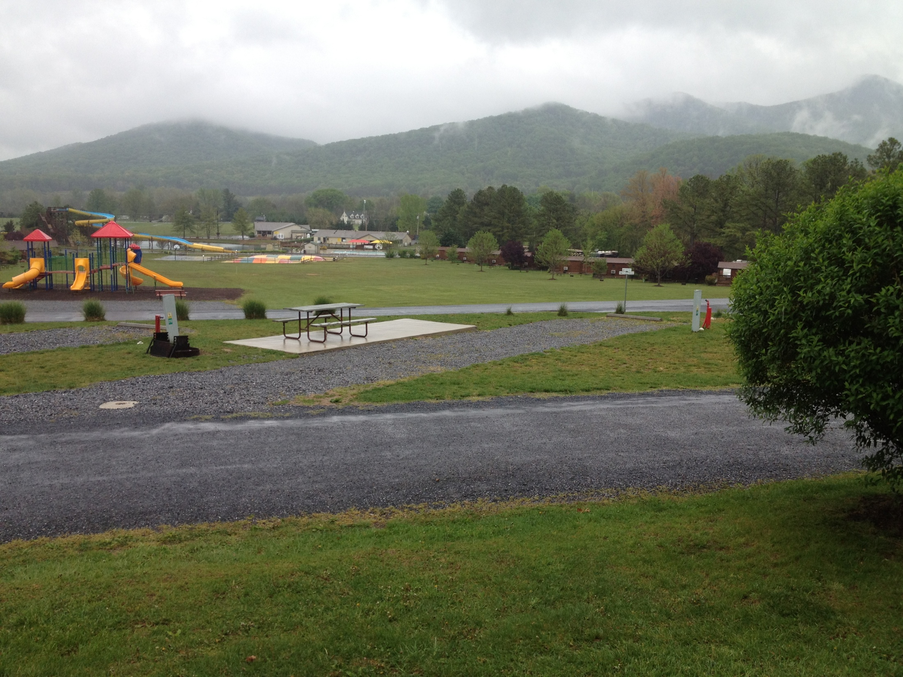
First Campground Loan December 1999: Jellystone Park-Virginia
Sold and Closed Friday, February 14, 2014
Sale Price: $10,300,000
Net Proceeds: Almost $8 Million

Slide 11
Campground Construction Projects and Construction Financing: Opportunities to take Advantage of and Pitfalls to be Avoided
First of all, there are aspects of Campground Construction Projects whether financing is involved or not.
What is the master plan for your park?
What is the mix of the project you are considering between:
  those that generate high ROI such as cabins,
  things that enhance your park to be more “resort like” like your landscaping, and
  infrastructure.
What are some of the areas that seem the most prone for overruns on projects in a campground?
Does your project warrant utilizing a General Contractor?
What has your history been for overruns on previous projects?
What is your contingency built into your project?
What if you go over 10%, 20% , 30% or 300%...by the way it has happened.
Ultimately, you shoulder the responsibility if things go haywire, so what can you do to mitigate risks with vendors etc.
Is the cheapest always the best?

Slide 12
Campground Construction Projects and Construction Financing: Opportunities to take Advantage of and Pitfalls to be Avoided
Next, is delving into construction financing. This adds another dimension to construction.
What are the hot buttons you can expect from a lender
What about things like:
  liquidity,
  contracts,
  bonding,
  title insurance
  disbursing agents and endorsements,
  lien waivers,
  general contracting,
  over runs,
  contingency budgets,
  contingency plans,
  weather etc.

Slide 13
First of all, there are aspects of Campground Construction Projects whether financing is involved or not.
What is the master plan for your park?
Farm example
Campground vs Day use
Village Supervisor request for layout of entire property

Slide 17
Things tend to take longer….
2016 First negotiated on purchase of land
09/2017 Under Contract
October-December 2017 Preparation and several public meetings
December 17 Zoning approval, Full civil and architectural drawings begin
February 28, 2018 Land taken down
After July 4, 2018 Excavation begins
February 2019 Contractor Mtg about hard date to take reservations June 28, 2019 with likelihood of capturing Memorial Day
April rained all but a few days
May rained all but a few days
June fair amount of rain
June 28, 2019 Opened new area 100 truckloads of rock, 2” of rain, 3” of mud (very hard on staff)
Mid-July 2019 through Labor Day mainly cabins still coming in (every site/cabin ready and available rented on weekends) One week 2 park models in on Wed, one Thurs 7:30 pm, all 3 rented and occupied Friday 4 pm
November 1, 2019 2 cabins to be delivered yet

Slide 18
Campground Construction Projects and Construction Financing: Opportunities to take Advantage of and Pitfalls to be Avoided
First of all, there are aspects of Campground Construction Projects whether financing is involved or not.
What is the master plan for your park?
What is the mix of the project you are considering between:
  those that generate high ROI such as cabins,
  things that enhance your park to be more “resort like” like your landscaping, and
  infrastructure.
What are some of the areas that seem the most prone for overruns on projects in a campground?
Does your project warrant utilizing a General Contractor?
What has your history been for overruns on previous projects?
What is your contingency built into your project?
What if you go over 10%, 20% , 30% or 300%...by the way it has happened.
Ultimately, you shoulder the responsibility if things go haywire, so what can you do to mitigate risks with vendors etc.
Is the cheapest always the best?

Slide 19
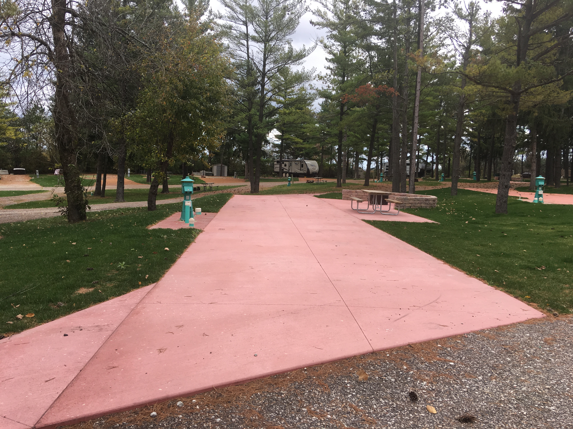
Premium Site with colored concrete pad,
patio, handicap fire pit (2019 Actual #)
92 Site Nights $8,677 Less 15% exp $7,375
92 SN @ $47 ancil $4,301 Less 60% COGS $1,720
Total Revenue $12,978 Total EBITDA $9,095
EBITDA $9,095 @ 10% Capitalization Rate $90,950
$9,095/10%= $90,950
Value of adding this site: $90,950
Cost of Site 20,000
Incremental Net Increase in Value of Park $70,950
Cost of Site/Gross Revenue=
Number of Years to Gross Cost of Site
$20,000/$12,978= 1.54 years
Cost of Site/EBITDA=
Number of Years to Net Cost of Site
$20,000/$9,095= 2.2 Years

Slide 20
Campground Construction Projects and Construction Financing: Opportunities to take Advantage of and Pitfalls to be Avoided
Next, is delving into construction financing. This adds another dimension to construction.
What are the hot buttons you can expect from a lender
What about things like:
  liquidity,
  contracts,
  bonding,
  title insurance
  disbursing agents and endorsements,
  lien waivers,
  general contracting,
  over runs,
  contingency budgets,
  contingency plans,
  weather etc.

Slide 21
Hot Button Questions that surface from time to time…
Equity or Skin in the game% (cash and or market equity…sometimes all cash required)
Why can’t you phase it?
Can existing cash flow carry it?
Is success based on projection?
You have grown 15% (or whatever) for the past 2 years what if you don’t next year?
What has been your overrun percentages in the past?
What is your plan for overruns?
Instead of a self-build, why don’t you hire a GC?
Is this in a flood zone, what are the typical ramifications including cost of insurance?

Slide 22
Questions

Slide 23
Campground Construction Projects and Construction Financing: Opportunities to take Advantage of and Pitfalls to be Avoided
By: Randy Isaacson
Campground Loan Coordinator
CCF Bank (purchased United Bank)
A Heart for the Campground Industry….
A Head for Business
Cell: 715-577-2320
risaacson@ccf.us
7001 S. Howell
Oak Creek, WI 53154
(15 minutes south of Milwaukee)
Office: 414-762-4886
Fax: 414-762-6241

Slide 24
