Slide 1
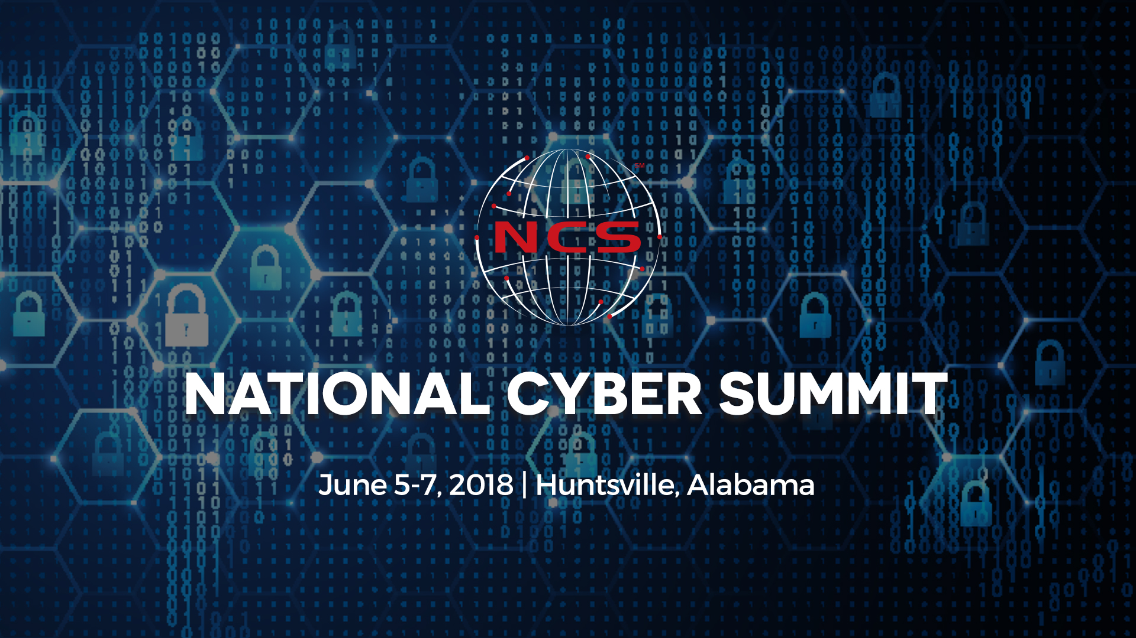

Slide 2


Risk Analysis for Financial Banking and Processing using Artificial Intelligence
Paul Wang, Ph.D.
Wayne Summers, Ph.D.
Taylor Woods, Student
Thursday, June 7, 2018. 3:30-4:15. North Hall – Salon 2

Slide 3
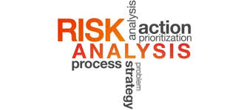


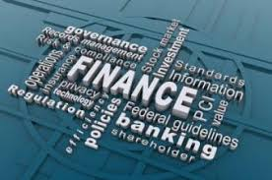



GDPR

Slide 4
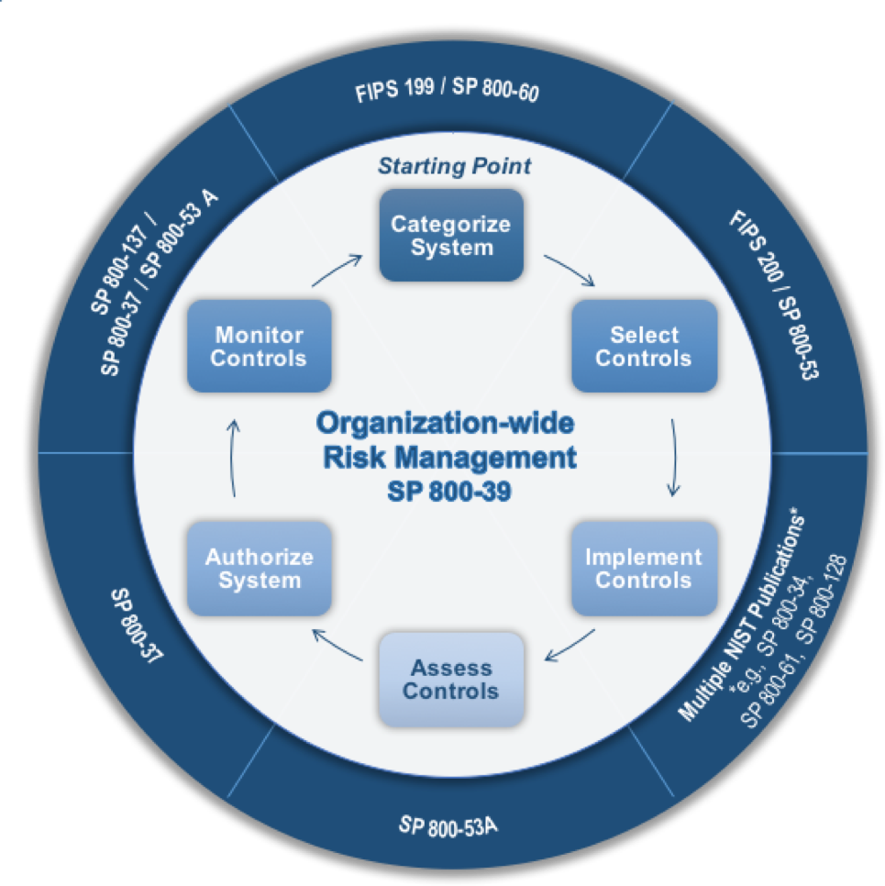
RMF 2.0
Categorize
Select
Implement
Assess
Authorize
Monitor

Slide 5





Slide 6
Content
Threats and vulnerabilities in financial banking industry and compliance
Academic-Industry collaboration
Cybersecurity workforce development
Risk analysis: from human intelligence to AI
Demo

Slide 7
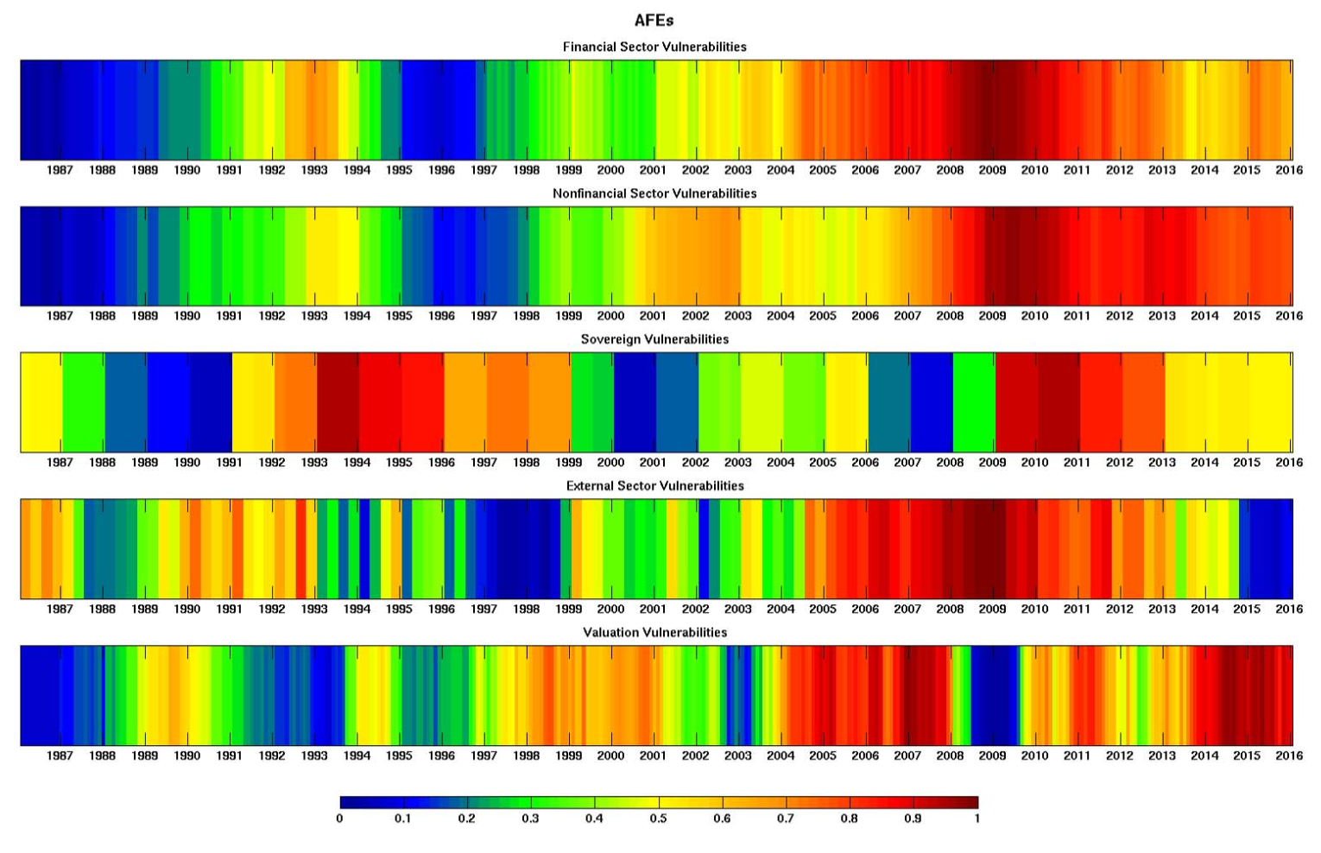
Heatmap of Vulnerabilities
Federal Reserve
Notes:
The EU General Data Protection Regulation (GDPR), Deadline: May 25, 2018

Slide 8
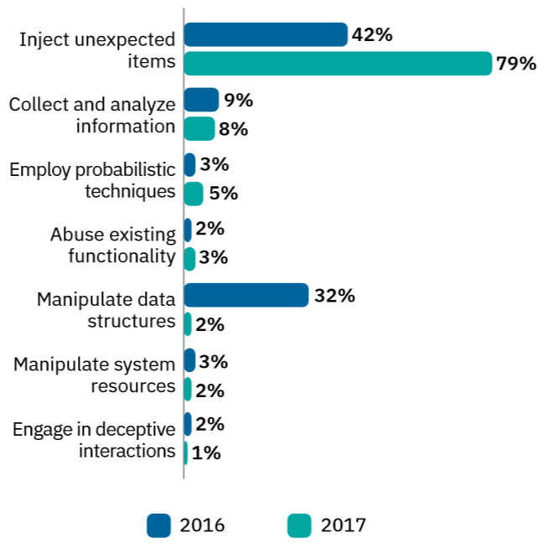
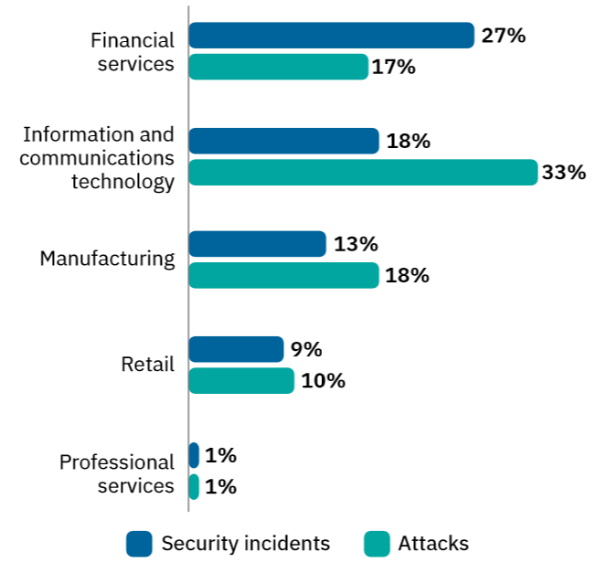
Threat Intelligence
IBM

Slide 9
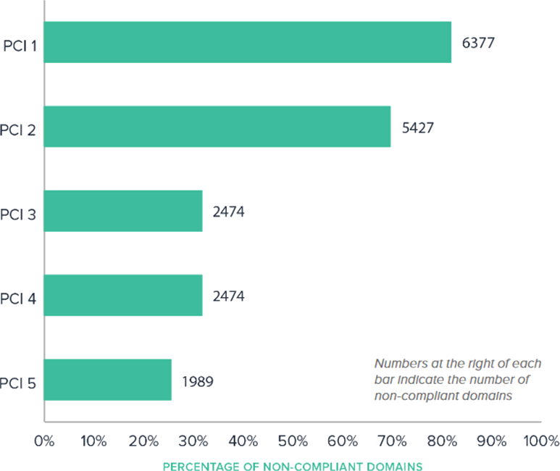
Non-compliant PCI responses by finance companies
PCI 1 Issue types associated with authentication for use of the technology [general information security]
PCI 3 Use strong cryptography and security protocols to safeguard sensitive cardholder data during transmission over open, public networks.
Source: SecurityScorecard

Slide 10
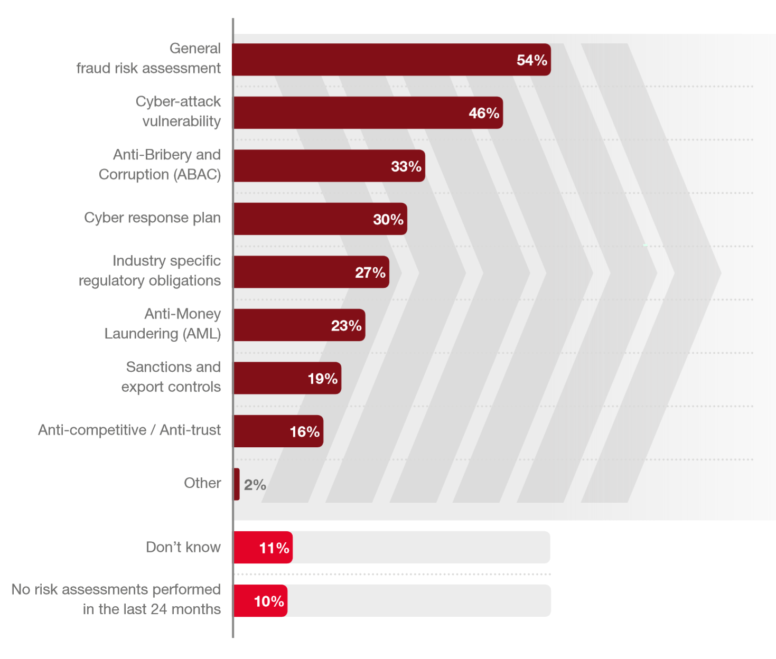


Organizations performed risk assessments (<50%)
GDPR
Source: PwC’s 2018 Global Economic Crime and Fraud Survey

Slide 11
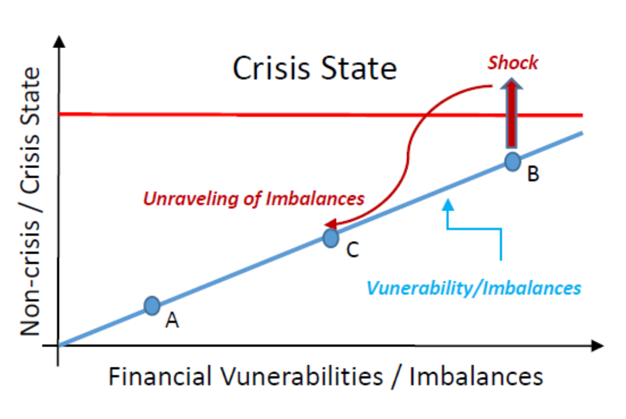
Financial Crisis Model
Federal Reserve

Slide 12
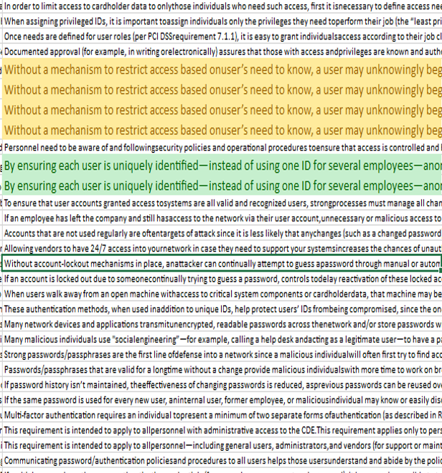
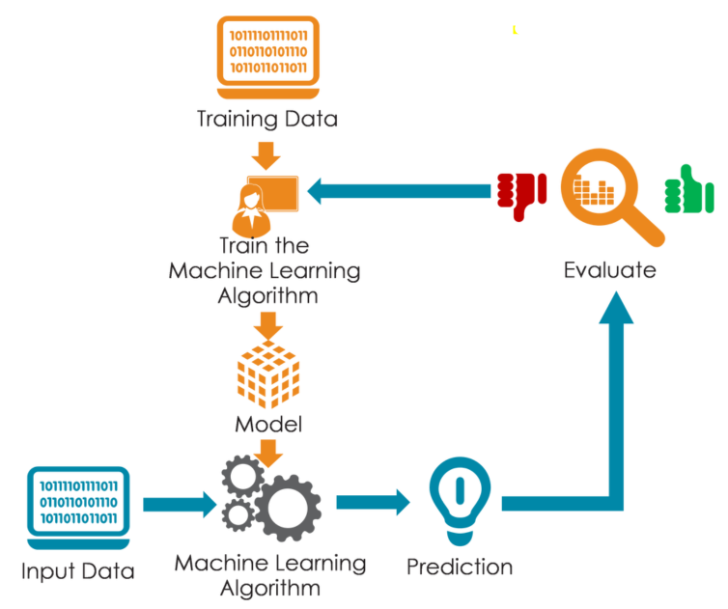

Risk Assessments

Slide 13
A Fundamental Issue
Academic-Industry collaboration
Cybersecurity workforce development
Wayne Summers
Chair TSYS School of Computer Science
Thursday, June 7, 2018. 3:30-4:15. North Hall – Salon 2

Slide 14
Academic-Industry collaboration
  TSYS needed mainframe programmers (1990s)
    ICAPP (10 course / 2 semester)
    Trained over 1000 mainframe programmers

Slide 15
Academic-Industry collaboration
TSYS Gifts
  2002 = $500K [treat like endowment; no strings]
  2006 = $170K [support hiring Security faculty]
    Used to train faculty

Slide 16
Today’s Challenge
TSYS (and everyone else) needs Cybersecurity Professionals
Cyberseek:
  US = 301,873
  GA = 10,927
  Columbus = 293
  TSYS = 30+

Slide 17
Academic-Industry collaboration
TSYS’s gift $5 million to CSU
$500K = Arts and Leadership Training
$2 million = Computer Science/IT (endowment)
$500K = startup Cyber Center
$2 million Sustain Cyber Center (endowment)

Slide 18
Building a Center for Cybersecurity
PROBLEM
“We gave you all of this money, where are our cyber employees?”

Slide 19
CSU Cybersecurity Programs
M.S. Applied Computer Science (2003)
I.S.O., I.S.P. Graduate Certificates (2008)
B.S. CompSci (Cybersecurity track) (2015)
Cybersecurity undergraduate certificate (2015)

Slide 20
PROBLEMS
“We don’t want computer programmers!!”
“We need them now!!”
“We want them to have skills and not have to train them!!”
=================================
“it takes 4 years to earn a 4 year degree”
“we graduate computer scientists”
“We educate, not train”

Slide 21
Georgia Solution – Nexus Degree
“intended for anyone interested in pursuing a high demand career “
18 credit hours with minimum requirement of 12 credit hours of upper-division courses
must include at least 6 credit hours substantive experiential learning component
not eligible for federal financial aid as a stand-alone option (low cost)
curriculum must be in direct alignment with the employment sector endorsed talent development framework

Slide 22
Risk analysis: from human intelligence to AI

Slide 23

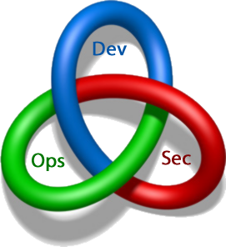
DevOps to DevSecOps

Slide 24
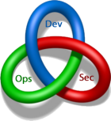
Security as Compliance
OmegaFi Information Security Policy
  PCI DSS v3.1 (2016)
PCI-DSS v3.2
  Payment Card Industry (PCI) Data Security Standard (DSS) Requirements and Security Assessment Procedures V3.2 (2016)
GDPR
  Enforcement date: May 25, 2018
ISO 13569
  Financial services -- Information security guidelines (2005)
ISO 27001
  Information technology — Security techniques — Information security management systems — Requirements (2013)

Slide 25
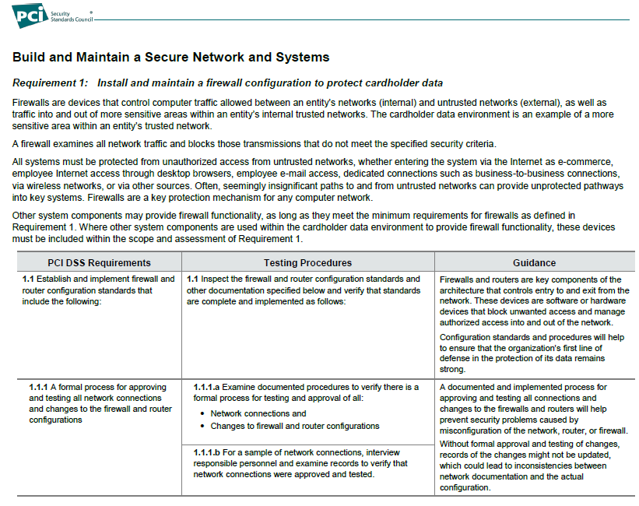
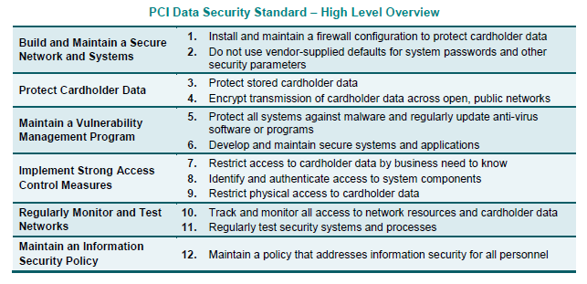
PCI-DSS v3.2
Goals and Requirements (left) | Requirement, Objective, Test Procedure, and Guidance (right)
Notes:
Goal==6, objectives==12, requirements==251, procedures==412

Slide 26
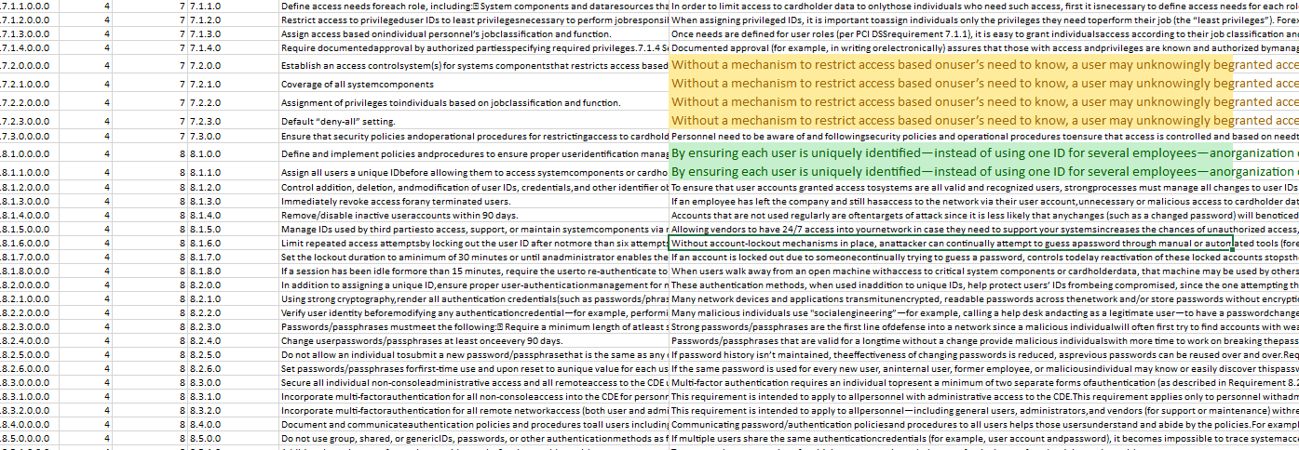
Duplications

Slide 27
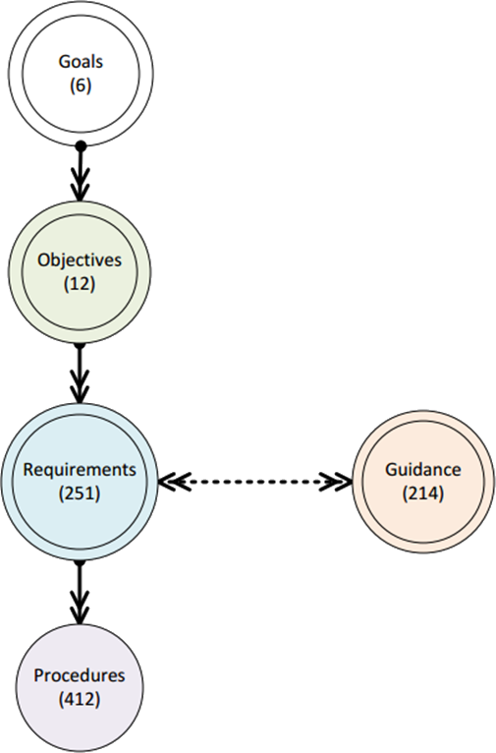
PCI-DSS v3.2
Architecture

Slide 28
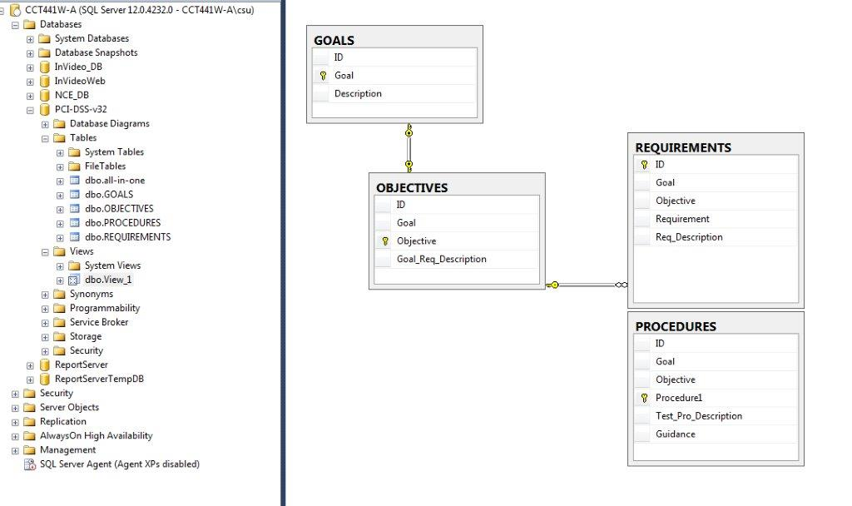
PCI-DSS – Database Diagram

Slide 29
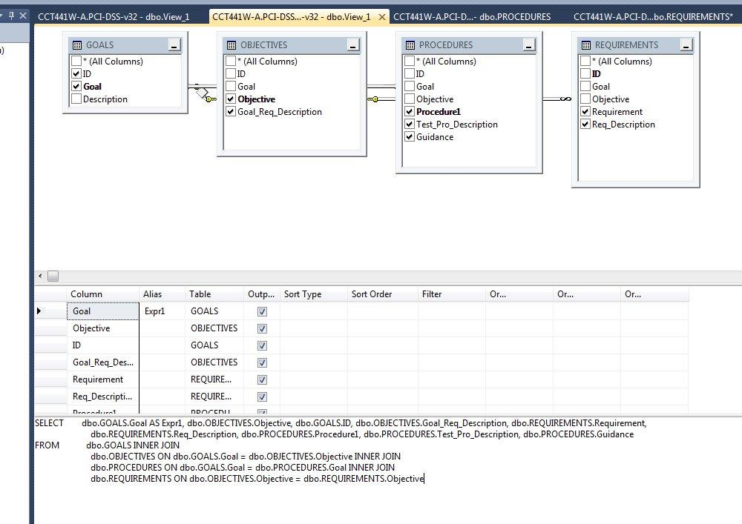
PCI-DSS v3.2 Framework relationships

Slide 30
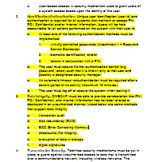
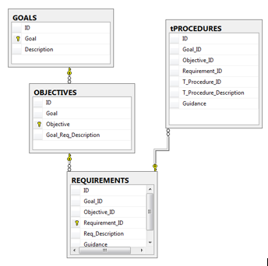
Compliance and Threat Analysis
Notes:
OmegaFi: Information Security Policy --- vs ---- PCI-DSS v3.2
G4 == 3 obj + 62 req + 101 tp, mapping 3: 16: 31
G2 == 2 obj + 27 req + 59 tp, mapping 2: 6: 20

Slide 31

Can we do better?

Slide 32
viCyber
Funded by National Security Agency
Intelligent Curriculum Development Tool
Assistant for rapid development of cybersecurity curriculum
Uses visual mapping combined with rule-based reasoning
Ensures course design is governed by the NICE framework by providing
  interactive feedback and
  suggestions for improvement during course design process

Slide 33
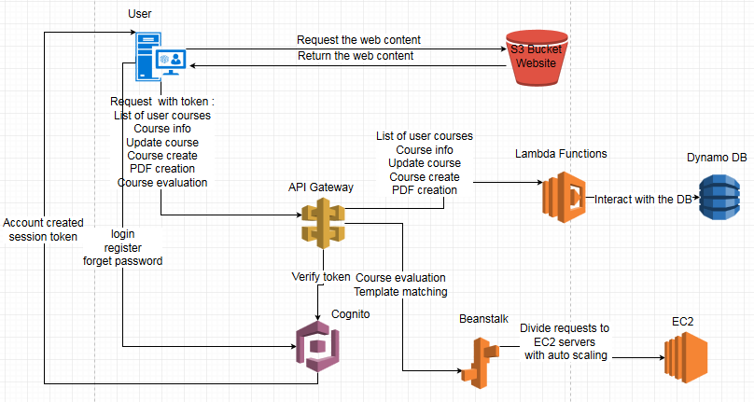
System Architecture
Notes:
Cognito: authentication, authorization, user management
API gateway: create, publish, access functionality from back-end services.
Lambda: store and run code without managing servers
Beanstalk: web apps with Java, .net, php, node.js, Python, Ruby etc. Like Apache and IIS
S3: storage and website files.

Slide 34
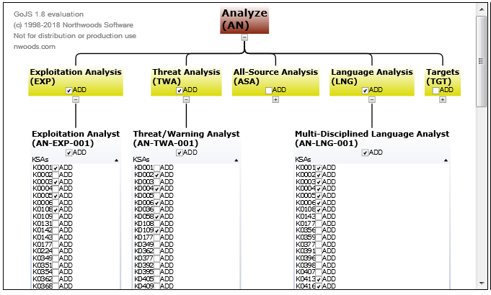
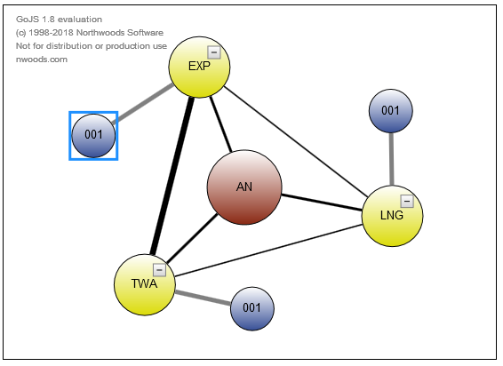
Curriculum/Training Design

Slide 35
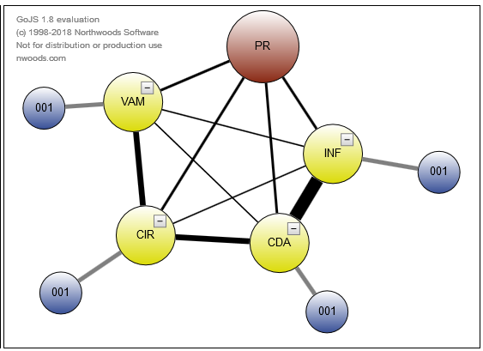
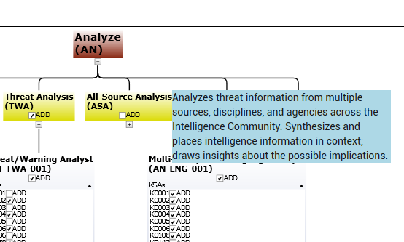
Evaluation
Strong connection
Mouse-over

Slide 36
Risk Analysis with Machine Learning
Machine learning is to gather a lot of information and let AI to
  Judge whether an input is “correct” within certain category. Or
  Predict an action.
Natural Language Processing (NLP) is a part of AI that deals with language (written or spoken)
GDPR Compliance analysis:
Dataset: GDPR
Model training
Evaluation
Deploy

Slide 37
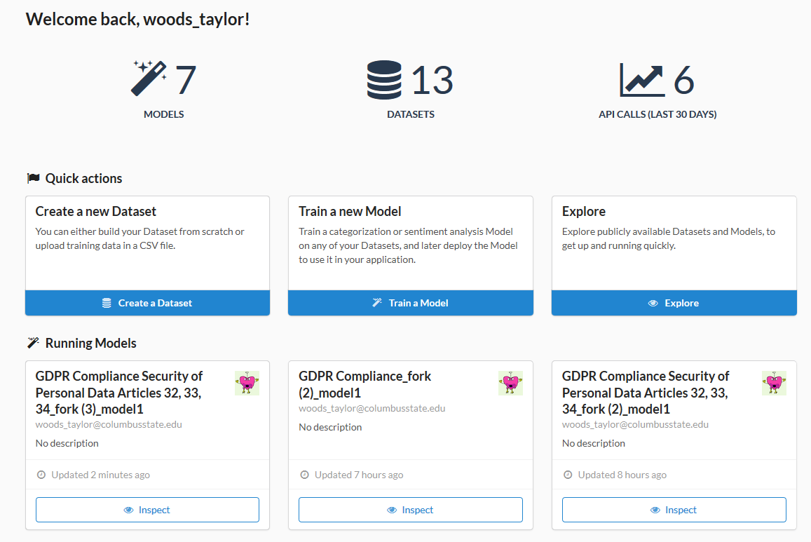

Slide 38
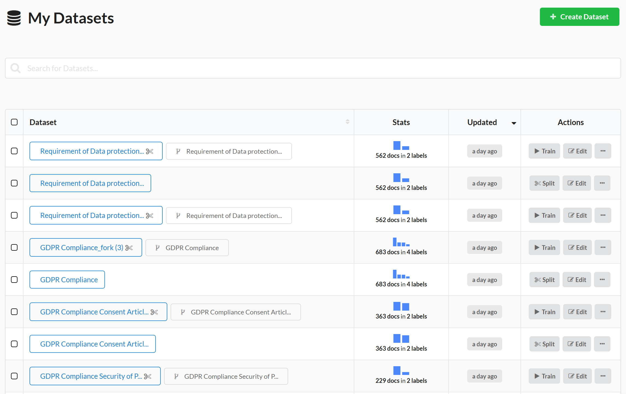

Slide 39
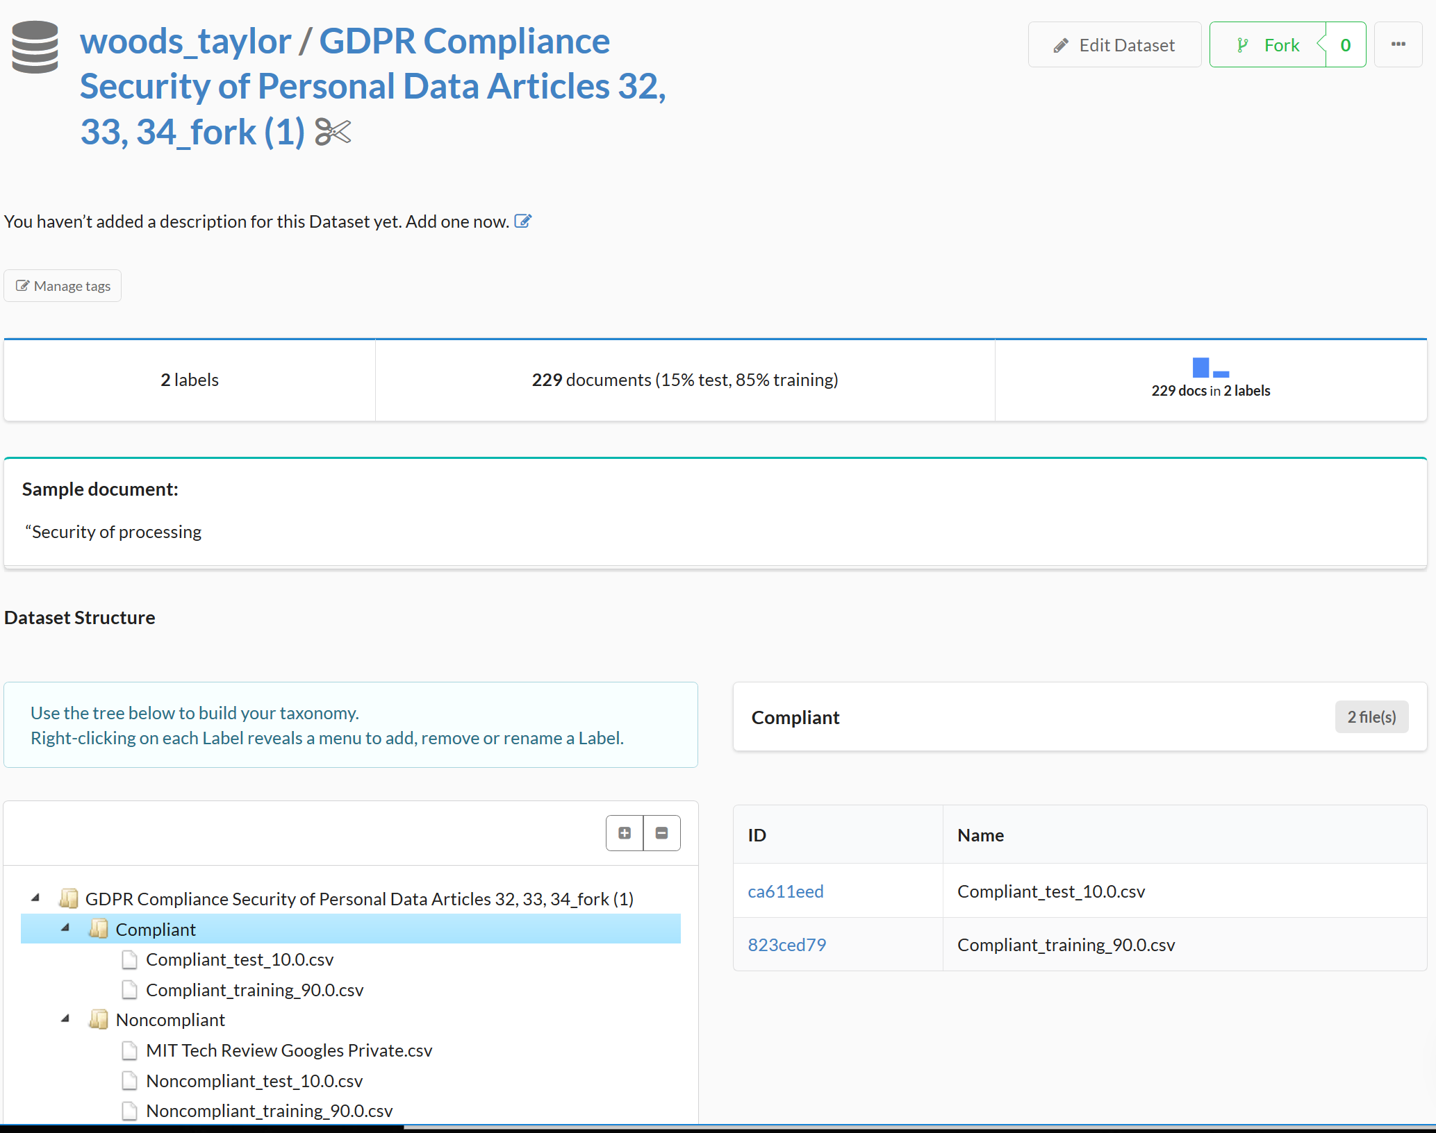

Slide 40
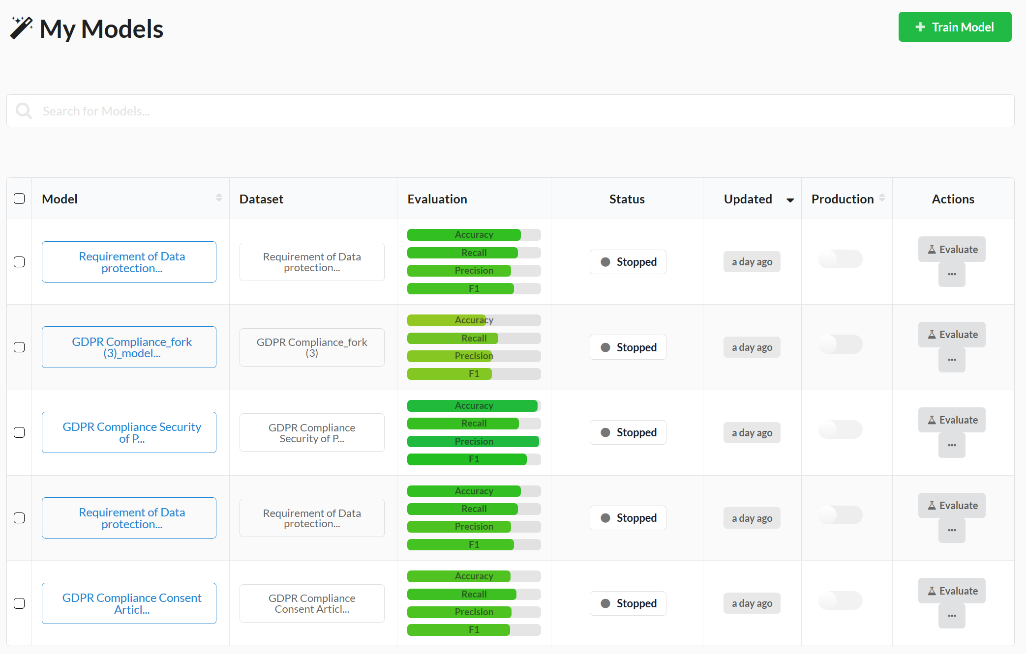

Slide 41
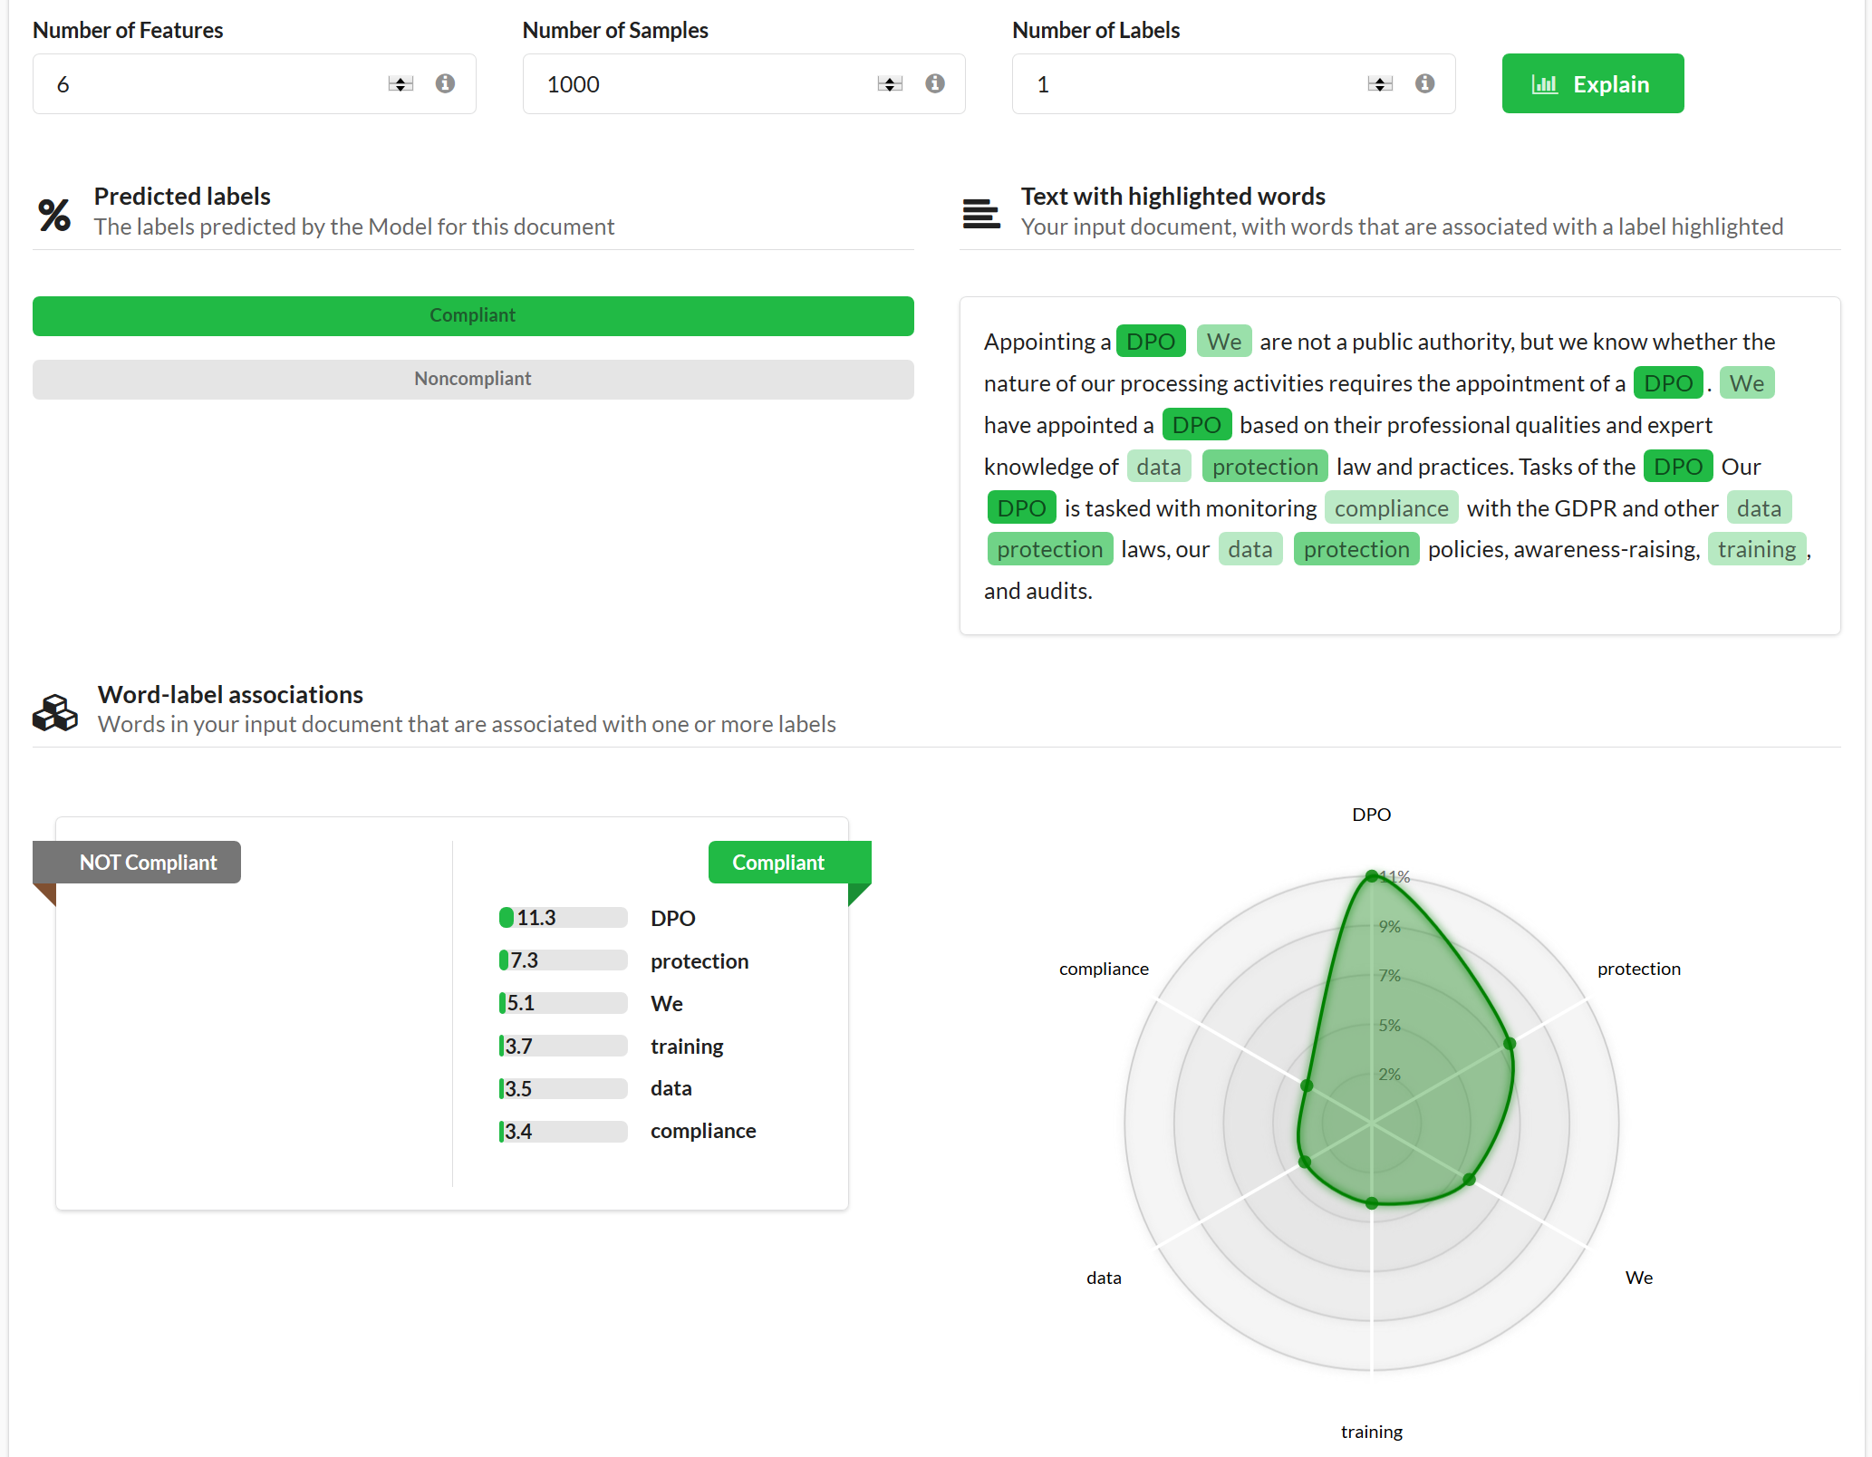

Slide 42
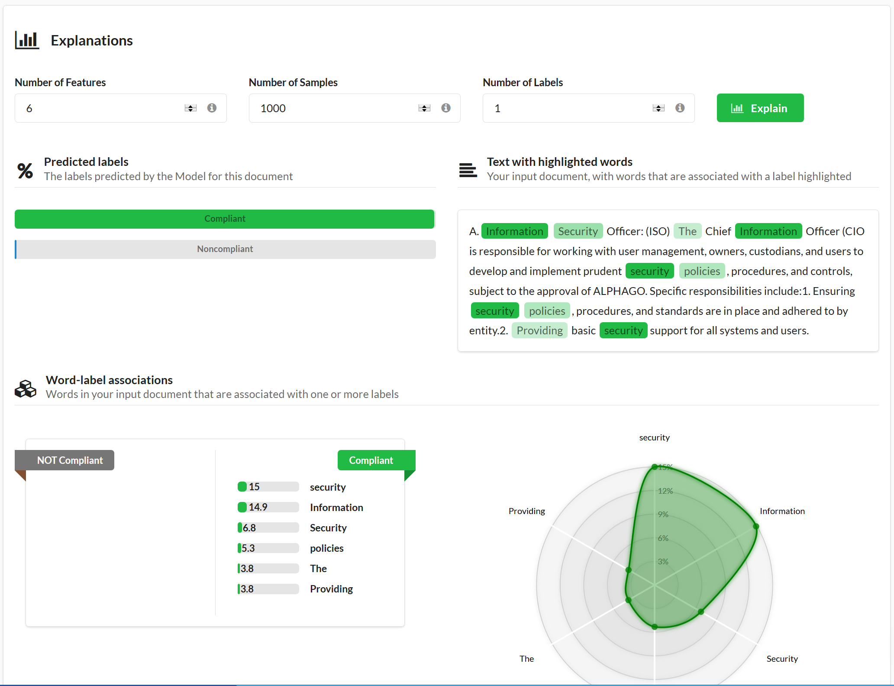
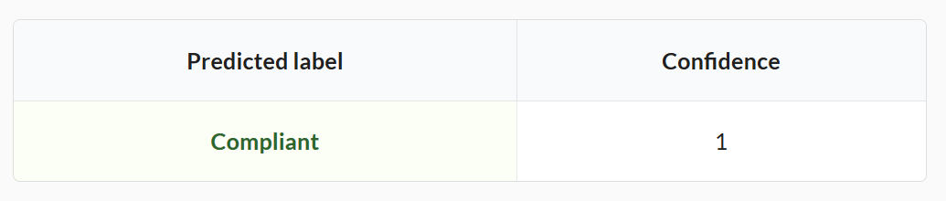
OmegaFi Security Policy

Slide 43
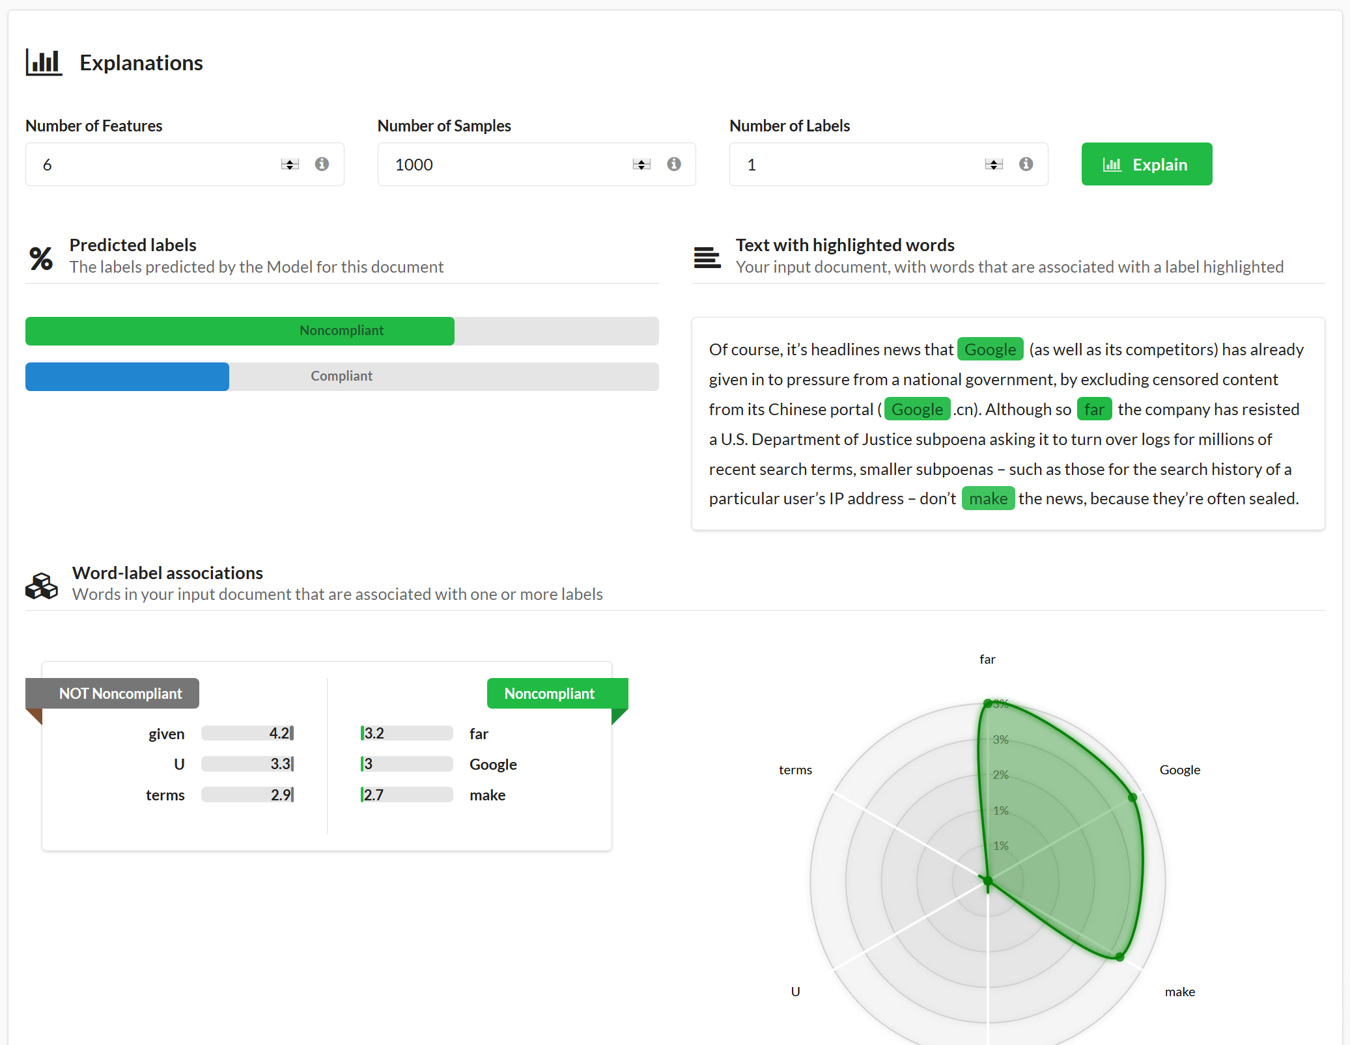
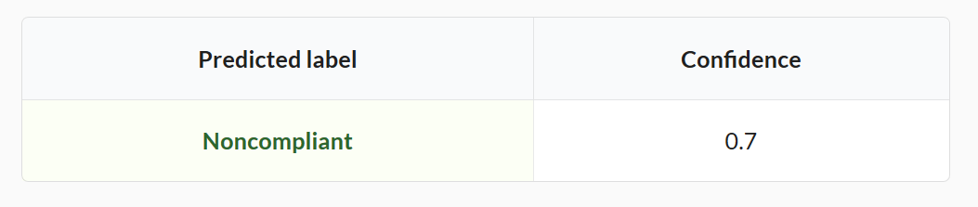
Google Privacy Policy

Slide 44
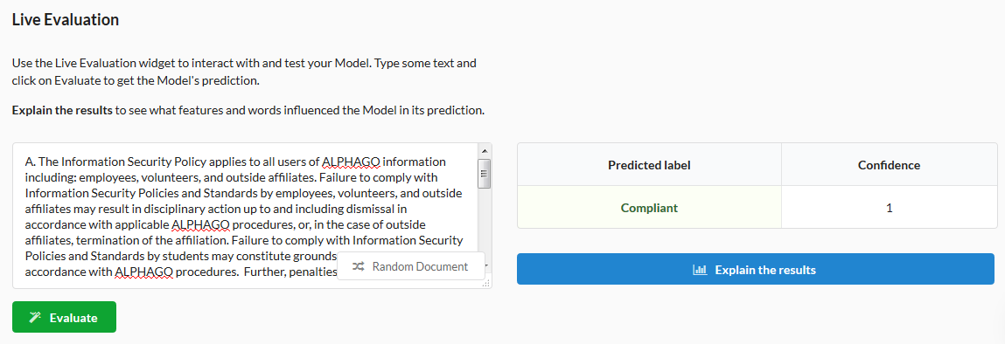
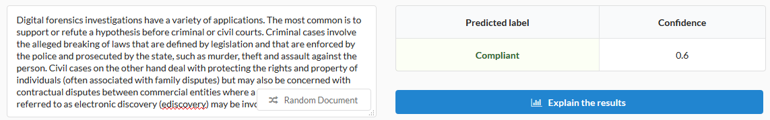
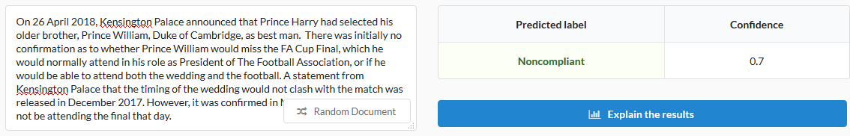

Slide 45
Demo
Risk Assessments using Machine learning
(for financial processing and beyond)

Slide 46
Cyber Risk Analysis
Real time systems
Penetration testing
Compliance/Privacy
Incident response

Slide 47

Take-away
Risk analysis for financial sector
  Excel -> Visual Mapping -> Machine Learning
PCI-DSS databases
GDPR Compliance – Machine Learning
  ISO, FISMA, HIPPA etc.
viCyber – AI tool for
  Cybersecurity training and workforce development
Cybersecurity = Hardware + intelligence + Software + Policy + Operation (HiSPO)
- Wang, 2015

Slide 48
Paul Wang, Ph.D. paul.wang@computer.org
703-629-7936 (cell)
@PaulSWang https://www.linkedin.com/in/paulwangedu/ http://csc.columbusstate.edu/wangp/

