Slide 1
UnHackable: A Mathematical Framework for Cyber Resiliency
National Cyber Summit, 06 June 2018
John Zimmerman, CAPT, USN (ret)
VP for Corporate Operations
Chief Cyber Strategist
SUBSYSTEM Technologies Inc

Slide 2
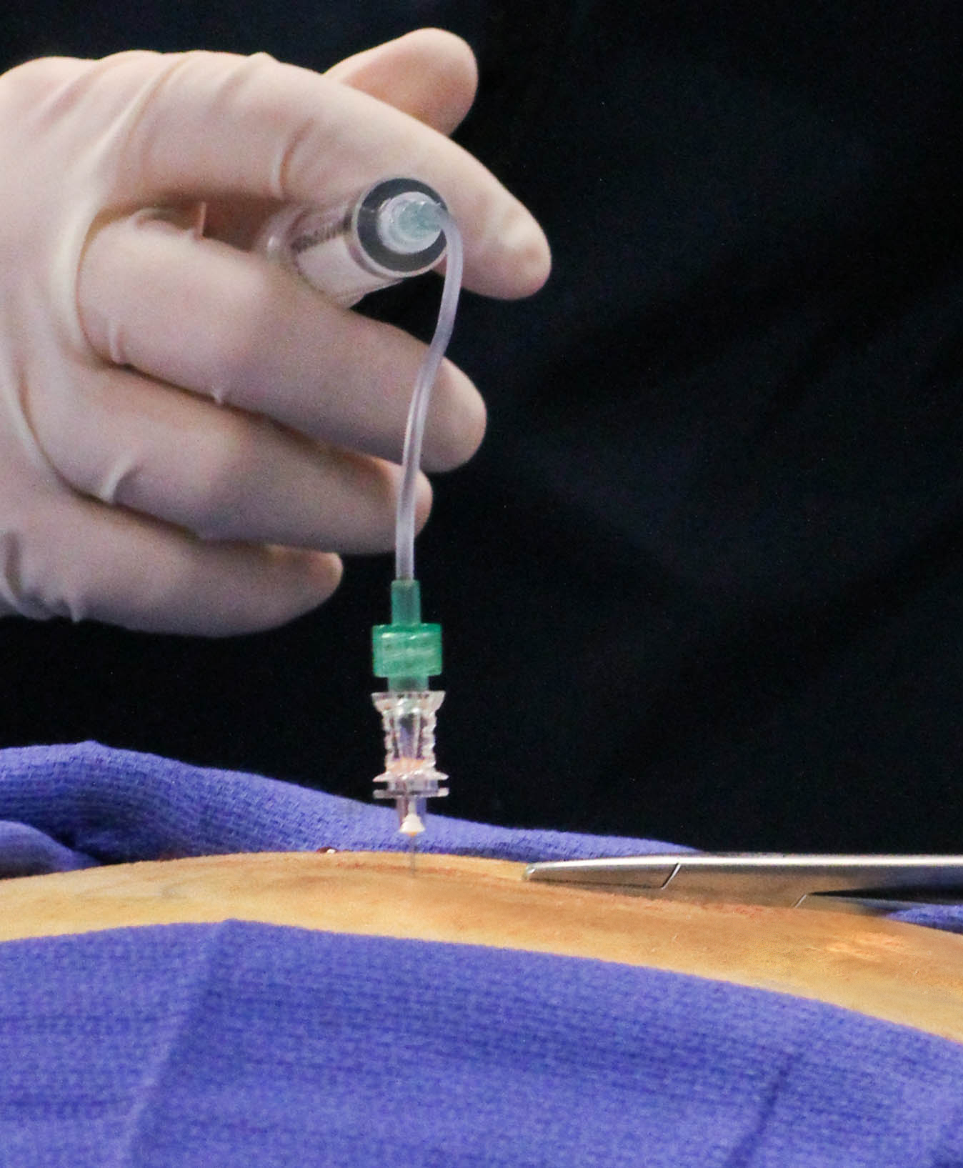
250-400K deaths each year are caused by Medical Errors.
Preventable medical errors Are Third Leading Cause of Death In U.S.
US News and World Report
03 May 2016
WIKIMEDIA COMMONS CC BY-SA 4.0

Slide 3
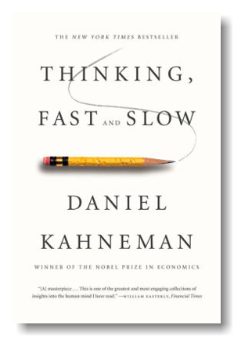
Thinking about Thinking
4 Cognitive Biases that hurt us in Cybersecurity
Cognitive Ease (Familiarity)
Confirmation Bias
Loss Aversion
Overestimate Low Probability events
Antidotes
Beware of clichés.
Can it be measured?
Critical (Slow) Thinking.
Opportunity Cost. Value?

Slide 4
The Perfect Cyber Strategy
“Our adversaries only have to find one way in, we have to protect them all”

Slide 5
The Plan for Perfection
Software Assurance
Hardware Assurance
Supply Chain Risk Management
Insider Threat
“We recommend the United States buy only secure products and services.”
Securing Cyberspace for the 44th Presidency. CSIS. 2008
Photograph: Eric Pouhier, Modifier: Rainer Zenz, Niabot (last modification)

Slide 6
Perfect Cyber Math
Service = Sys {(sw₁) (sw₂)…(sw_{n})} {(hw₁)(hw₂)…(hw_{n})} {(pe₁)(pe₂)…(pe_{n})} {(me₁)(me₂)…(me_{n})} {(el₁)(el₂)…(el_{n})}
Service = Sys {(sw_{n})(hw_{n})(pe_{n})(me_{n})(el_{n})}
No Service (0) = Sys {(sw(0))(hw_{n})(pe_{n})(me_{n})(el_{n})}
sw – software
hw – hardware
pe – personnel
me – mechanical
el – electrical
sw_{n} – “n” number of software vulnerabilities in a system that can be exploited to disable its service.
No Weak Links

Slide 7
Threats and Vulnerabilities: A never ending race
Threats: Can you keep the bad guys out?
You will never know the threat perfectly.
Unknown Threats.
Threats are always changing.
Vulnerabilities: Can we eliminate them all?
Vulnerabilities are endless.
Today’s secure hardware and software is tomorrow’s vulnerability.
Average Life Expectancy of Zero Days – 6.9 years.
People are human
Unknown Vulnerabilities
“They are going to get in. Get over it.”
Michael Hayden
Former Director, NSA and CIA

Slide 8
Time is Running Out
Andreas Weith (CC BY-SA 4.0)

Slide 9
Cyber Risk
Risk = f (Threat)(Vulnerability)(Consequence)

Slide 10
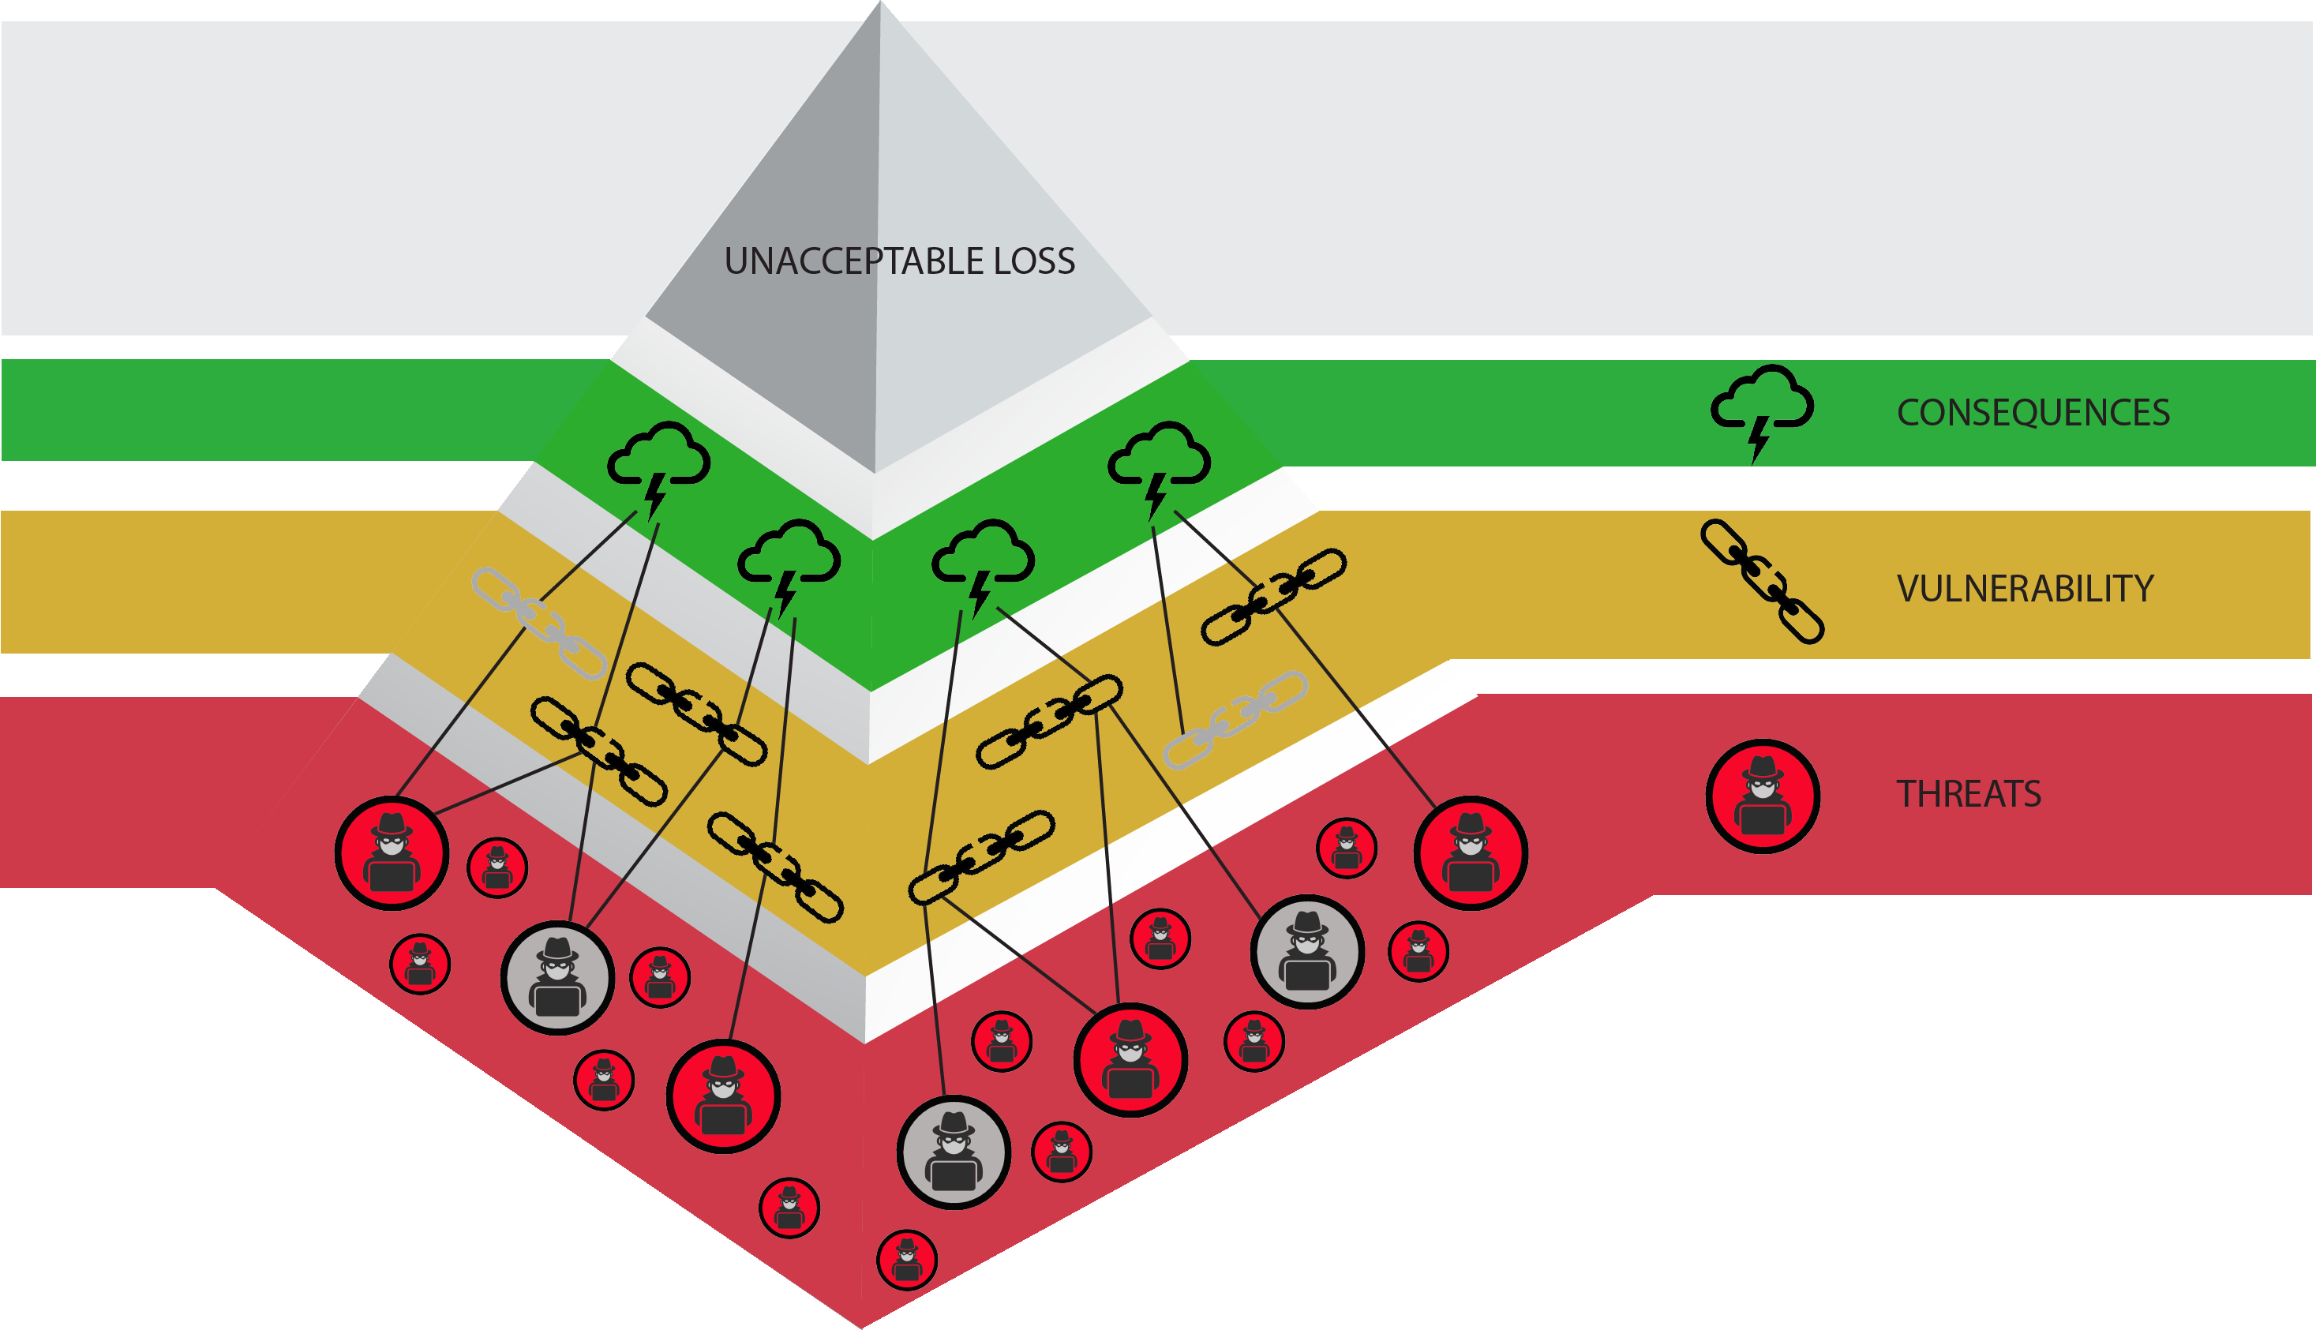
Hierarchy of Cyber Risk
Consequences
Loss of Service
Loss of Information
Loss of Life
WHY
What
Who
Risk = f (Threat)(Vulnerability)(Consequence)

Slide 11
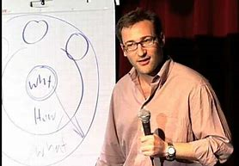
Start with WHY
Simon Sinek
Consequence is the only factor in the Risk equation that can be known and addressed in advance of any cyber attack or system failure.
By Stefan Krause, Germany

Slide 12
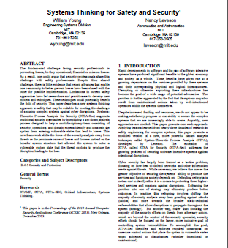
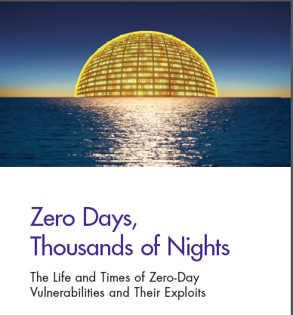
Who is using Consequence?
“rather than focusing the majority of the security efforts on threats from adversary action, which are beyond the control of the security specialist, security efforts should be focused on the larger, more inclusive goal of controlling system vulnerabilities. ”
Systems Thinking for Safety and Security
Professors Leveson and Young,
Massachusetts Institute of Technology
“defenders may be able to shift the balance in their favor by starting from the assumption of compromise and investigating ways to improve system architecture to contain the impact of compromise…”
RAND Study
Zero Days, Thousand Nights
US Navy Nuclear Power Program.
90 Million Miles w/o a Nuclear Accident
The current … entrepreneurial and technology energy when it comes to cyber-risk, is in consequence management. It’s the presumption of breaches. It’s about resiliency.”
Michael Hayden
Former Director, CIA and NSA

Slide 13
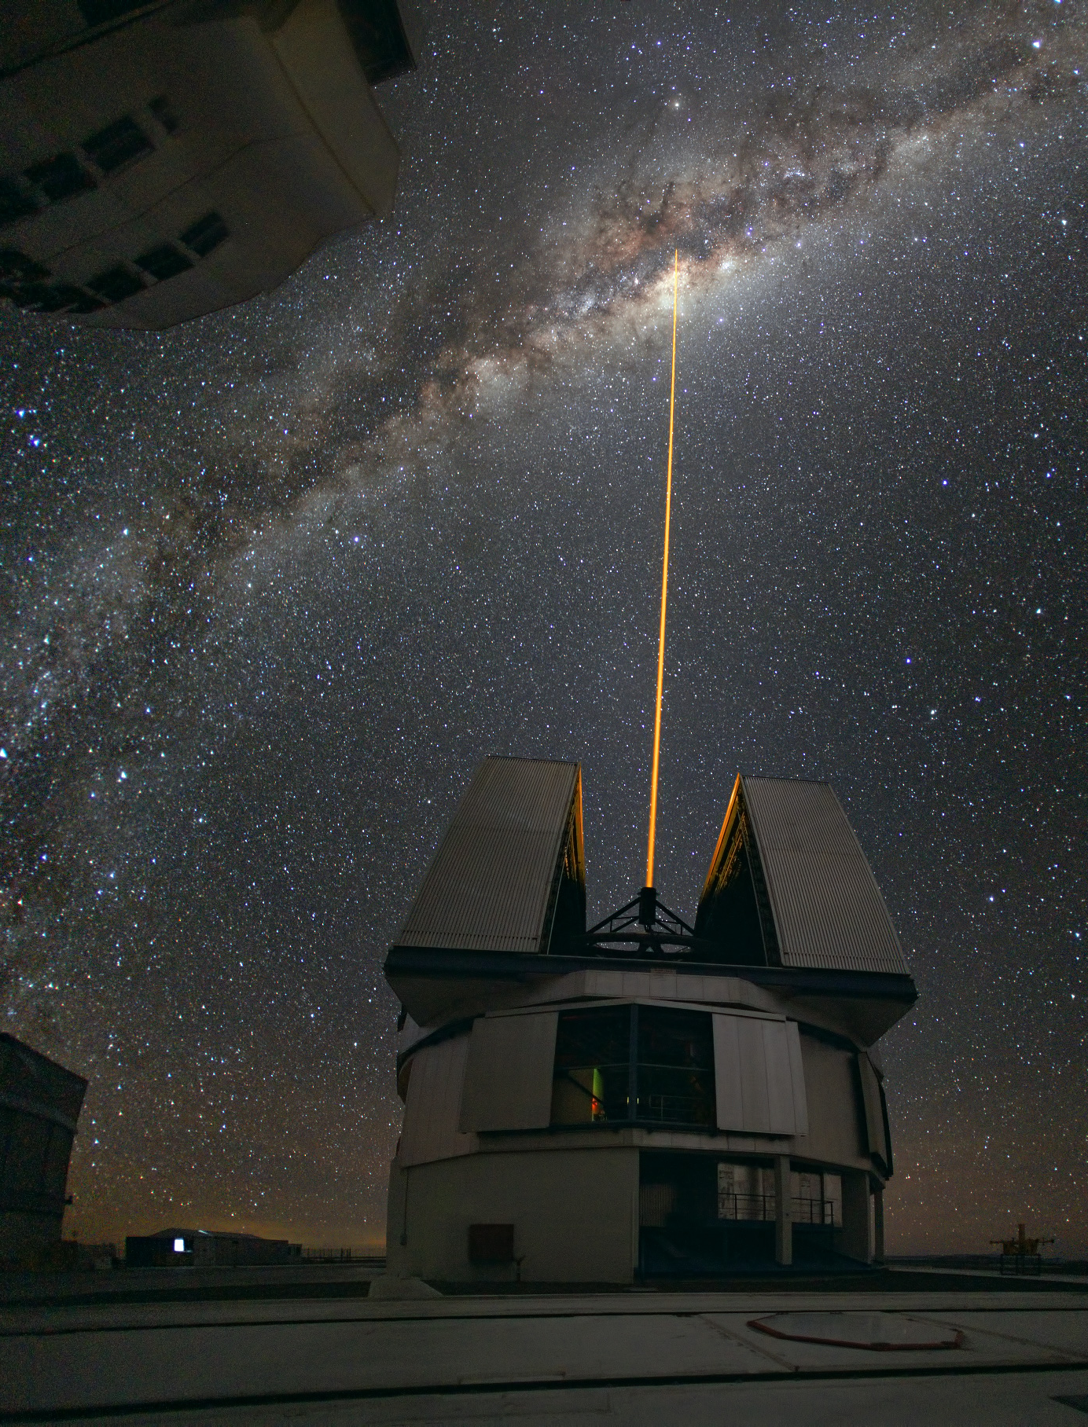
Resilience
“Resilience is the capacity of any entity – an individual, a community, an organization, (or system)… – to prepare for disruptions, to recover from shocks and stresses…”
Judith Rodin, President Emerita, Rockefeller Foundation

Slide 14
Resilience Mathematical Framework
Service = Sys {(sw_{n})(hw_{n})(pe_{n})(me_{n})(el_{n})}
Service = Sys {(sw_{n})(hw_{n})(pe_{n})(me_{n})(el_{n})} +
Sys {(sw_{n})(hw_{n})(pe_{n})(me_{n})(el_{n})} +
Sys {(sw_{n})(hw_{n})(pe_{n})(me_{n})(el_{n})}
Perfection?
Each Resilient state provides a unique/diverse solution to mitigate, constrain, or eliminate an unacceptable consequence.
“Three is Two, Two is One, and One is None”

Slide 15
UnHackable
A System of Systems that ensures consequences are effectively constrained, mitigated, or eliminated so unacceptable losses cannot be created by cyber attack.

Slide 16
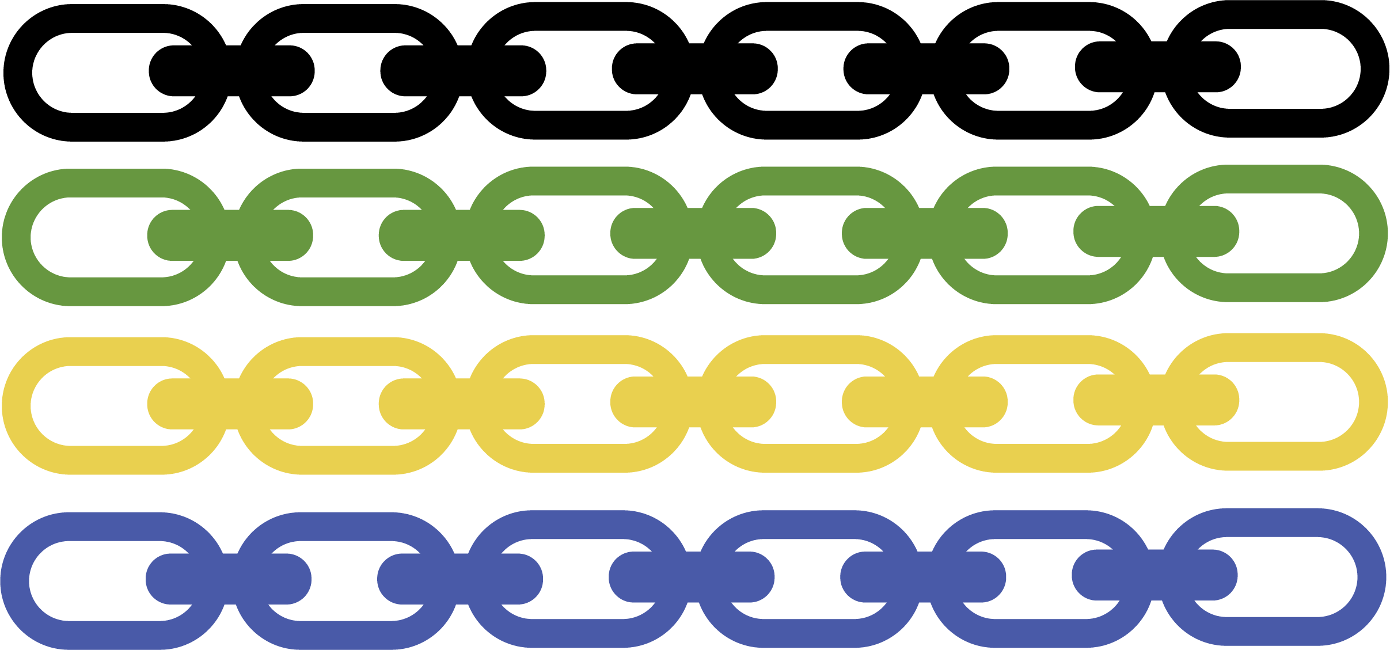
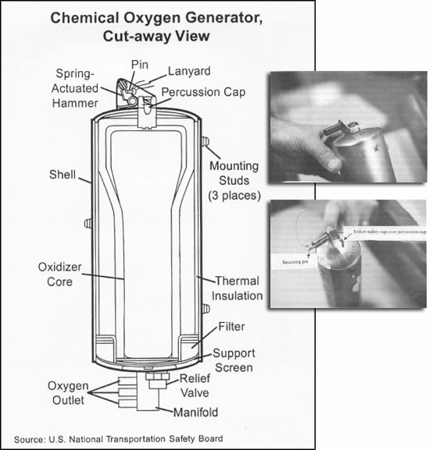
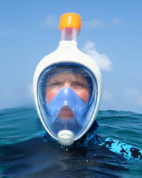
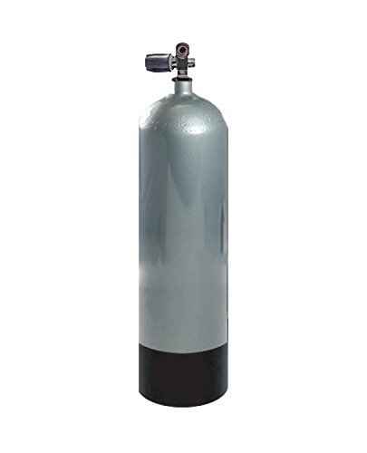
“All I need is the air that I breathe…”
Oxygen Service =
Oxygen Generator {(sw_{n})(hw_{n})(pe_{n})(me_{n})(el_{n})} +
Oxygen Candle Furnace {(pe_{n})(me_{n})} +
Oxygen Banks {(me_{n})(el_{n})} +
Snorkel System {(hw_{n})(pe_{n})(me_{n})(el_{n})}

Slide 17
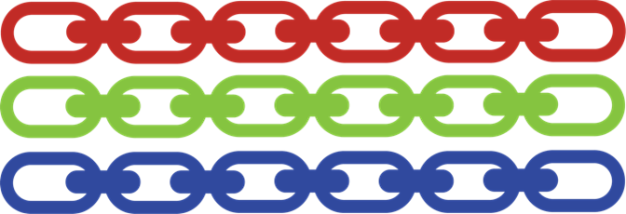
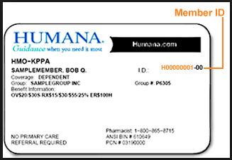
Loss of Medical Records – Future Ransomware
Medical Record Access =
On Premise Solution {(sw_{n})(hw_{n})(pe_{n})} +
Cloud Solution {(sw_{n})(hw_{n})(pe_{n})} +
Patient Solution {(sw_{n})(hw_{n})(pe_{n})}

Slide 18
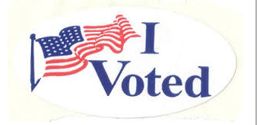
Election Hacking
Accurate Vote Count =
Digital Voting Machine {(sw_{n})(hw_{n})(me_{n})(pe_{n})} +
Printed Ballot/Vote Counter {(sw_{n})(hw_{n})(pe_{n})} +
Election Observers (process) {(pe_{n})} +
Election Observers (process) {(pe_{n})}
Digital voting machine tallies vote and prints paper ballot.
Voter puts paper ballot in adjacent machine that tallies vote via separate software and hardware.
Multiple election observers ensure that digital machine and vote counter machine reach same vote count, or,
Paper ballots used to provide accurate vote.

Slide 19
Cybersecurity: Not a Perfect Story
By Maurizio Pesce from Milan, Italia - Edvard Munch: The Scream (1895, signed 1896), CC BY 2.0

Slide 20
The Choice is Yours
Consequence & Resilience
Perfect Security

Slide 21
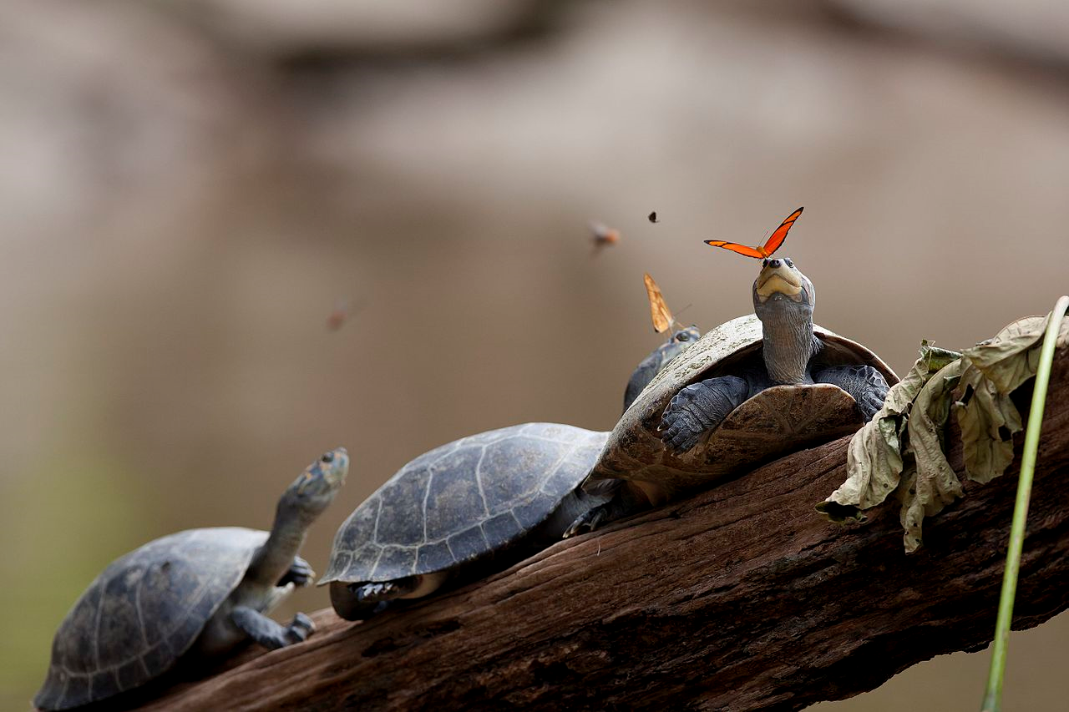

Slide 22
UnHackable: A Mathematical Framework for Cyber Resiliency
Questions?
John Zimmerman
jzimmerman@subsystem.com

