Slide 1
CLINICAL MODIFICATION IN ROOT CORRECTION PHASE IN SEGMENTED ARCH TECHNIQUE
World J Orthod 2006; 7: 59-64
Daniel Ianni Filho, DDS, MS
Klaus Fernando Cardoso Bernardo, DDS
Adriana Prad Calheta DDS
Eduardo Serpa Vieira, DDS

Slide 2
Shape driven versus force driven mechanic
Force-driven mechanics, which have a statically determinate force system. With a statically determinate force system , the entire force system can be calculated by the use of the principles of statics or equilibrium.
You know precisely the amount of force you apply on each unit, his sense and direction as a resulte you can predict how each element will move.
To be able to do this you must work with a limited number of unit. Idealy two

Slide 3
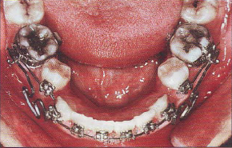
Shape driven versus force driven mechanic
The defect are:
It is technique dependent
There is no fail safe. If the wire is deformed by the occlusal force unwanted tooth movement will occure without limitation
It also is more voluminous in the buccal cavity
In this case the lingual arch was broken, the patient did not came to fix it. As a result there was a rotation of the posterior unit.
In continuous archwire technique the wire would have limited this mouvement.

Slide 4
Shape driven versus force driven mechanic
Shape-driven mechanics, which have a statically indeterminate force system. With a statically indeterminate force system, the ent ire force system cannot be easily calculated because of interaction between the forcesystems developed at the active or reactive unit.
You use a serie of shape and fixe the teeth to it. The teeth will adapte themself to the new shape

Slide 5
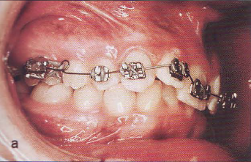
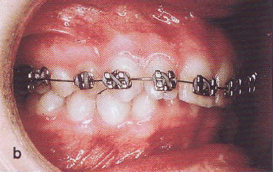
Shaped driven versus force driven mechanic
The defect are :
If you know what the shape is you do not know were it will be.
You cannot know or control the intensity and direction of the force exert on each tooth
In this case we want to intrude the upper incisor for to correct the deep bite.
The teeth adapt to the shape but by an extrusion of the lateral, not an intrusion of the central

Slide 6
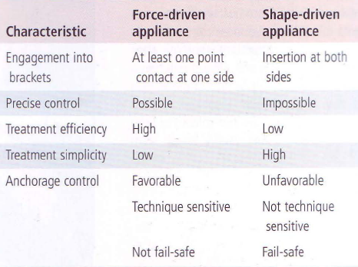
Shape driven versus force driven mechanic

Slide 7
The segmented mechanic principle and rational
The mechanics of the segmented arch technique.
Angle Orthod 1966; 36:99-120
Burstone CJ
Rationale of the segmented approach to orthodontic treatment
Am J Orthod Dentofac orthop 1995;108:1-8
Stanley Braun, DDS, MME, and Michael R. Marcotte, DDS, MSD

Slide 8
The segmented mechanic principle
An orthodontist should have control over the following parameter
The moment to force ratio
The magnitude of the moment or force
The constancy of the force
A well-designed appliance should offer
Delivers constant moment to force over a long range of activation
The center of rotation of an active unite should be predictable
The force system at the reactive unit should be know and predictable
PREDICTABILITY AND CONTROL

Slide 9
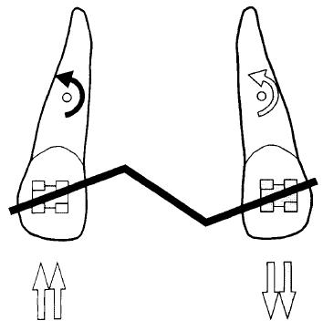
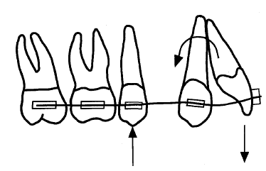
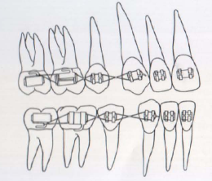
The segmented mechanic principle mechanical advantage predictability
With a straight wire the force system is easily predictable with two element.
However when the wire is engage in the full arch, it is not possible to know the force system anymore.
In certain often encounter situation it can be partially predicted by experience.
Determine force system
Undetermine force system
For example in the extraction case with mesially incline canine, experience tell us that the canine will be tip mesially and that this movement can be suppress by using a ligature wire. But it is not possible to know that only by looking to the teeth

Slide 10
The segmented mechanic principle mechanical advantage predictability
In the segmental technic usually no more than three element interact with each other.
One basic principle is to limit the number of elements

Slide 11
The segmented mechanic principle mechanical advantage range of force
Because the unit are larger the distance between the point of application of two force will also be longer.
This as two very important consequence
1 The range is more important
2 A wider range of force is possible

Slide 12
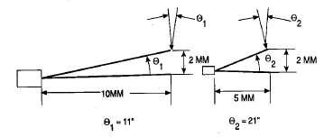
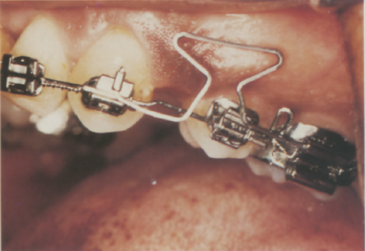
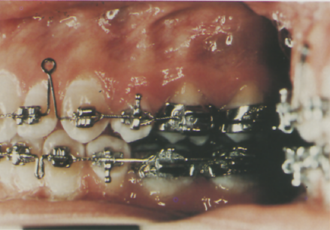
The segmented mechanic principle mechanical advantage range of force
Because the deflection range is more important the direction of range is more important the direction of the force is more constant.
For example for a cantilever during 2 mm of intrusion
There is a variation of the angulation of the force of 11° with a length of 10 mm
There is a variation of 22° when the length of the arm is 5°
The deflection range will be longer, so activation have to be less frequent. Because of the segmental design only one segment need to be change and not the whole arch.

Slide 13
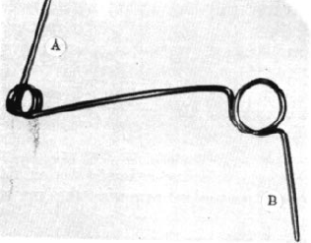
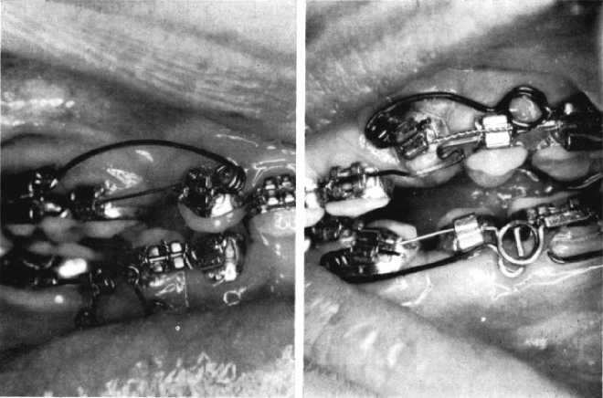
The segmented mechanic principle mechanical advantage range of force
Because the deflection is more important wider range of force can be obtain for useful movement.
For example a spring used for tiping segment, by using a 0.018×0.025 SS a moment of 3500gm/mm can be obtain. The same level can be obtain with a continuous wire but on a range too small to be clinicaly usefull and the side effect are not controlable.

Slide 14
The segmented mechanic principle mechanical advantage range of force
A classic a application is the uprighting of a seconde molar.
If a continuous wire was used a whole sequence of wire would have to be used, to allow the big wire diameter to be used.
The reactive force would be exerce mainly on the first molar leading to a possible canting
By using a segmental mechanic the reactive force is evenly distributed on the arch minimising the unwanted tooth movement

Slide 15
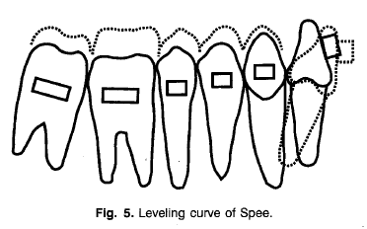
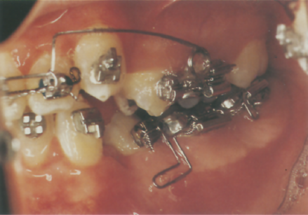
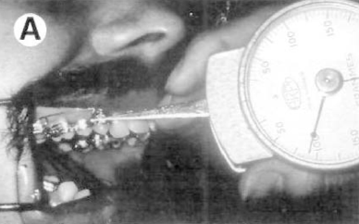
The segmented mechanic principle mechanical advantage range of force
Intrusion of the lower incisor necessity extremely low force. With a reverse curve of spee arch two problem
1 The force deliver to the incisive cannot be measured and the direction of the force can not be controlled
2 The force are too important and lead to and extrusion of the posterior sector. This effect is increase as the wire increase in size.
With the segmented technique the long range of activation means that low force can be delivered consistently with a relatively constant direction. The force can be precisely measure and adapted to the patient which can be very useful with patient presenting a loss of alveolar bone.
Publication have show that true incisor intrusion is obtainable by segmented technics ( intrusion arch or utility arch) but the range of movement obtainable is less important than with miniscrew also there will be movement on the anchorage segment

Slide 16
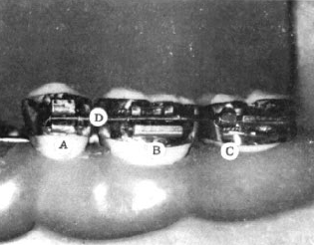
The segmented mechanic treatment sequence
During the first phase of treatment the futur unit are chosen.
The teeth are level and aligne in each segment if the unite is more than one teeth.
Once align he teeth are solidarize with a rigid wire inside each unite. It is the BASE ARCH.
In the posterior sector the use of bracket and tube is recommanded
The tube is use for the insertion of the base arch
Pr Burstone advise the use of a 0.0215×0.028 stainless stell wire in the posterior sectore.
To be able to move the teeth as one unite the teeth have to be solidarized together by a rigide and passive system
Because there is few teeth by unite the wire bending is more easy and predictable.

Slide 17
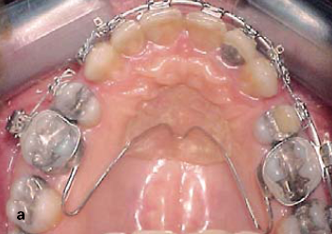
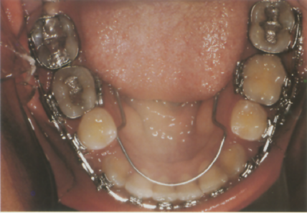
The segmented mechanic treatment sequence
Usually the posteriror segment are soliderize together
The force are then applied from one unit to the other (usually no more than thee unit)
At this stage because only segment are moved withou sharing a common archwire only frictionless mechanic will occures

Slide 18
The segmented mechanic treatment sequence
Because there is no archwire to guide the unite during the movement and prevent rotation, the unit are moved by using a Begg like mechanic.
The crown is first type in on direction
Then the apex is move in the same direction

Slide 19
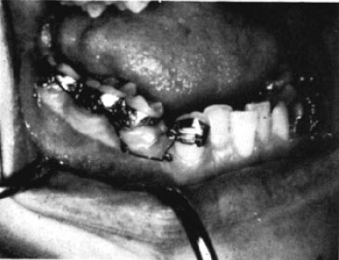
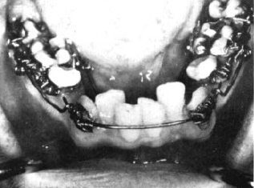
The segmented mechanic treatment sequence
In extraction case if there is initially not enough space for aligning the anterior segment the canine are first retracted then the anterior segment is then aligned

Slide 20
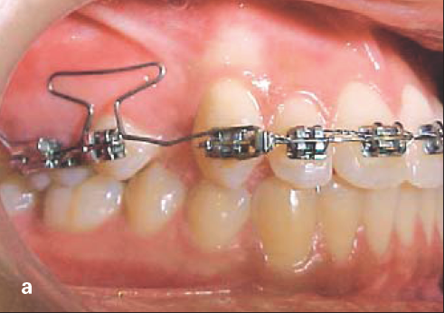
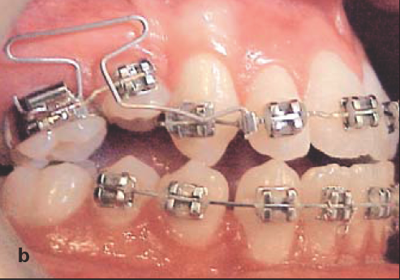
The segmented mechanic treatment sequence
The segment are then level and aligne in relation to each other. It is at this stage that canting, asymmetry or midline deviation are corrected.
Once a correct relation has been obtain the space are closed by tipping
At this stage the occlusion worsen sgnificantly.

Slide 21
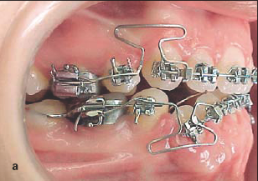
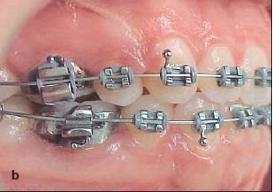
The segmented mechanic treatment sequence
When the space are close and the axe of the segment corrected continous archwire are used
Levelling and the finishing are then performed for obtaining correct occlusion and esthetics resuts

Slide 22
CLINICAL MODIFICATION IN ROOT CORRECTION PHASE IN SEGMENTED ARCH TECHNIQUE
World J Orthod 2006; 7: 59-64
Daniel Ianni Filho, DDS, MS
Klaus Fernando Cardoso Bernardo, DDS
Adriana Prad Calheta DDS
Eduardo Serpa Vieira, DDS

Slide 23
Rational for this article
When space closure between the two unit have been obtain by tipping of the crown of one of the unite, the next step is to correct the axis of each unite
At this stage there is a strong tendency of space reopening between the two unites.
To counteract this tendency Burstone advise to use a ligature before to do corrective root tipping.
But even with this method space reopening is frequent.
This article describe a modification of the segmented arch technic to counter this tendency.

Slide 24
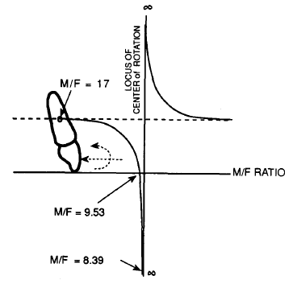
Space closure in SAT
During the space closure the unit are moved by typing.
Because there is only two unite at this stage the force system is perfectly determinate
The force apply can be control both in intensity, sense and direction. As a result the M/F ratio is controlled
The basic principle is to tip the crown of the unite you want to move and tip the root of the unite you want to keep in the same position.

Slide 25
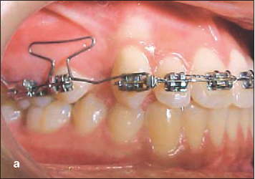
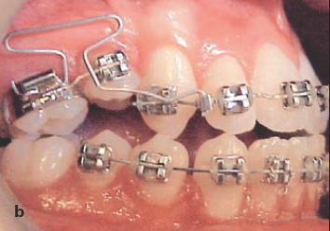
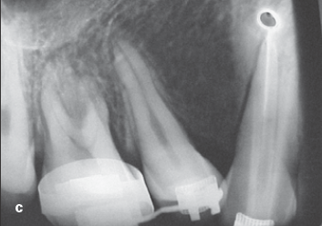
Space closure in SAT
For example in this case you want to mesialize the posterior unit and conserve the position of the anterior unit.
The moment to force ratio is adapted to produce crown tipping of the posterior unit and root tipping of the anterior one

Slide 26
Space closure in SAT
There will also have an intrusive force on the unite were the crown is tip and an extrusive fore on the unite were the root are torque
This can be better understood with the V principle

Slide 27
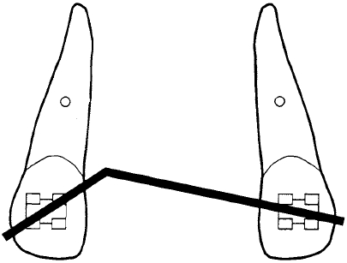
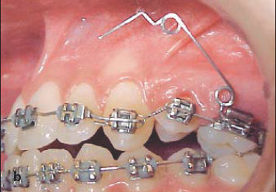
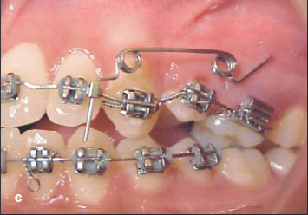
Space closure in SAT
Study have shown that when a V-bend is place at a distance of 1/3 between two bracket the following system will be created.
This can be simulated with a spring by creating an angle of activation of 45° on one unite and an angle of 15° on the other one
As a result the two unit will come closer to each other in the vertical dimension

Slide 28
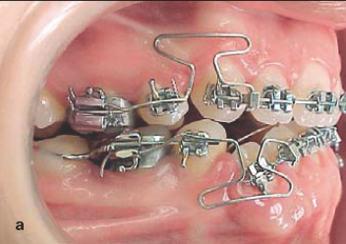
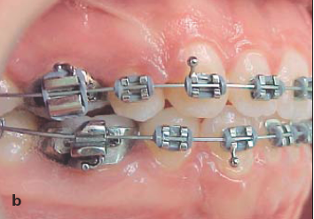
Space closure in SAT
Ligature wire will not prevent space reopening
As the two unite came to the same level the distance between two ligatured teeth will decrease and the ligature will become loose allowing space reoppening.

Slide 29
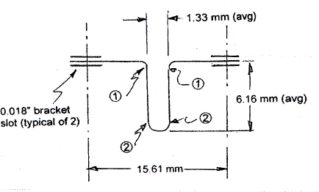
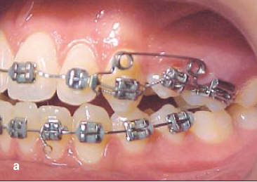
Space closure in SAT
Study have also shown that when a bend is preactivated in all case a horizontal force will be generated
In the case of the root spring the horizontal component on each spring act in opposite direction and tend to reopen the space

Slide 30
Space closure in SAT
The ligature wire are ineffactive because they become loose.
To solve the problem the autor suggest to applied an opposite horizontal force using a NiTi coil spring.
In this case elatic are inadecate because there is a rapide decay of the force they delivered
The root spring delivers the opening force constantly,

Slide 31
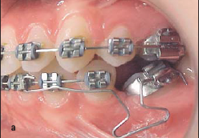
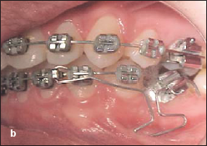
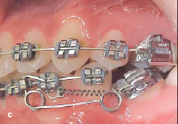
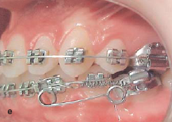
Space closure in SAT
The space is first close in a classic way by tipping the crown
When the root spring is engaged, a Niti coil spring delivering a force of 300 gm is fixe on the two segments
If space beggin to appear the clinician know that the force is not sufficient and must be increase

Slide 32
Conclusion
Even in following this protocol the author observe that in some case space will appears
Further study are needed on the properties of NiTi close spring.

