Slide 1
How to use ImageJ to perform mahidol cephalometric analysis

Slide 2
Step one
Download the two excel files
Download ImageJ and install it on your computer
http://rsbweb.nih.gov/ij/download.html

Slide 3
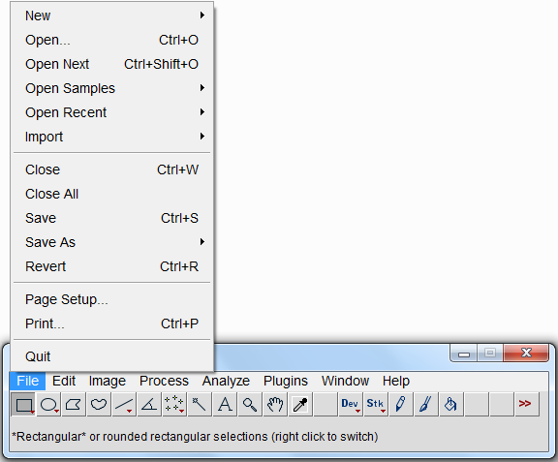
Step two
Open the software
Click the File button, the Open
Open the x-ray you want to analyze. You may need to convert it to jpg first

Slide 4
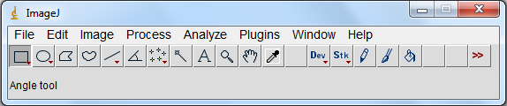
Step 3
The Basic command of imageJ: moving
Use the scrolling tool
Or press space bare and left click on the mouse

Slide 5
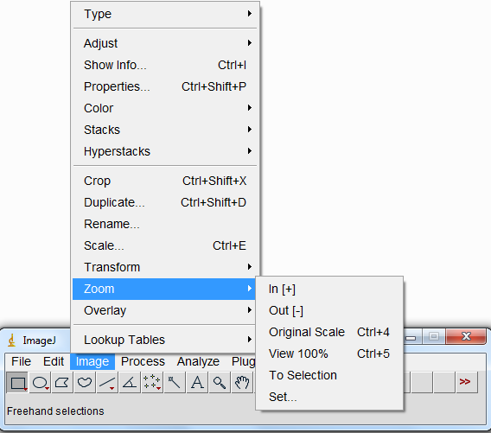
Step 3
The Basic command of imageJ: Zoom
Zoom in +
Zoom out -
Or go in : image > transform > zoom

Slide 6
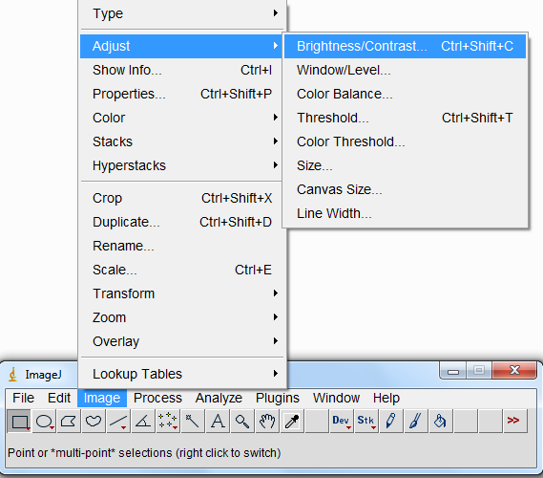
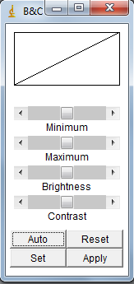
Step 3
The Basic command of imageJ: brightness and contrast
Go to Image > Adjust > Brightness/contrast
A window will appear, Keep it on the side of the work space

Slide 7
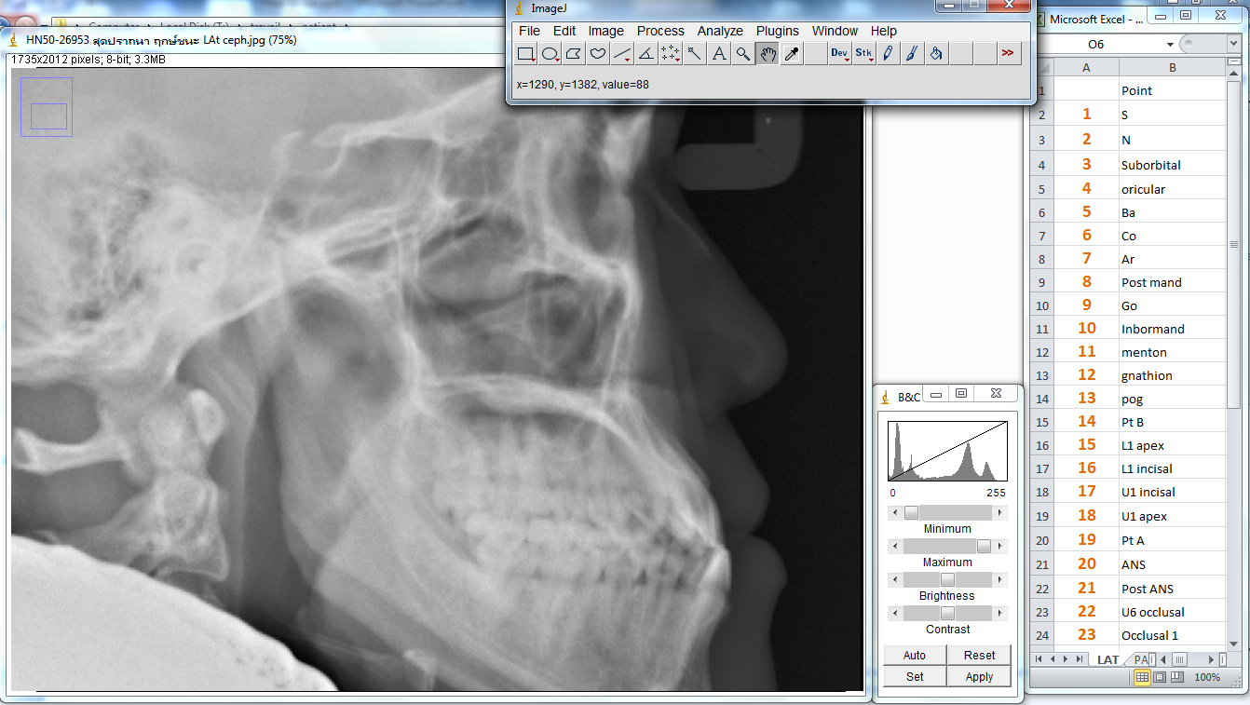
Step 4
Open the excel file for male or female depending on the patient gender and put in on the side of the screen to know in what order you have to select the point
You should have the main window of imageJ and the little window for the contrast

Slide 8
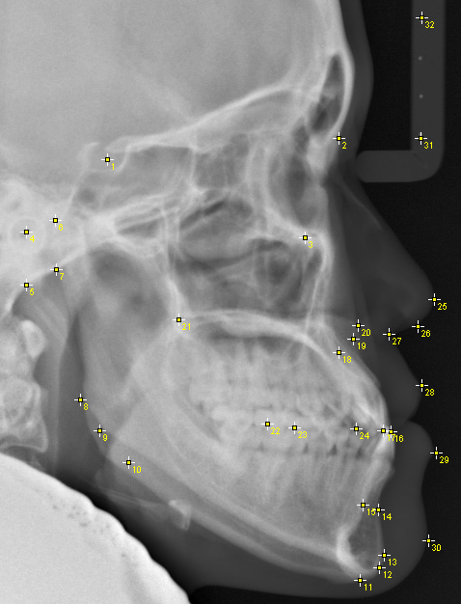
Step 5
Click each point is respecting the sequence
You can move each point just by clicking on it
An example with all the point

Slide 9
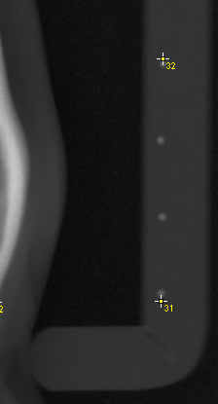
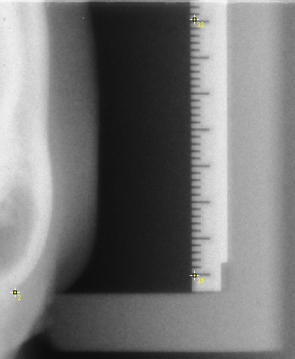
Step 5
For the point 31 an 32 you have to indicate the real distance in mm between the point
For the knew X ray machine the distance between the point is 31 mm
For the old machine just use the ruler on the side : in this example you have to put 35 mm in the case 33
For the PA analysis there is no ruler you have to measure a distance on the film manually and use it as a reference on the scan

Slide 10
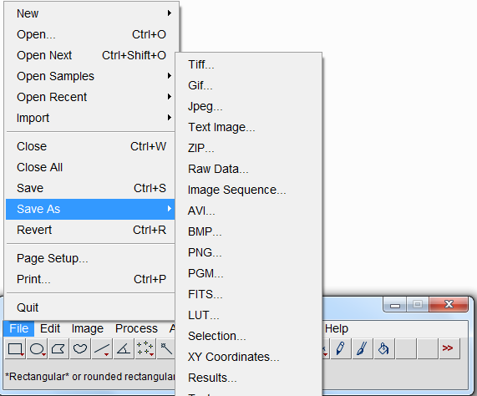
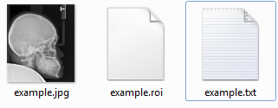
Step 6
Saving your point
When finish go to File> Save as
Save as > selection that will create a .roi file ( this will allow you to keep your point )
Save as > XY coordinate this will create a .txt file ( to use with excel )

Slide 11
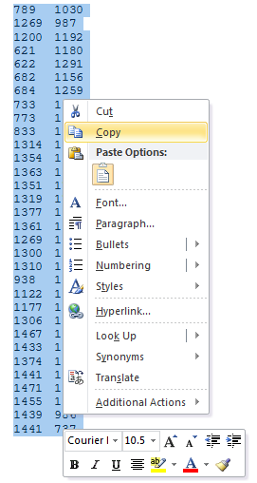
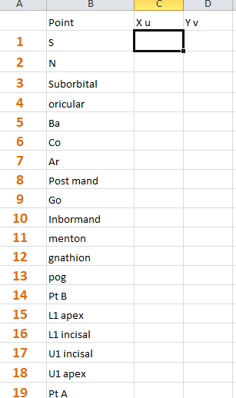
Step 7
Open the .txt file the coordinate of the point are display
Copy everything
Select the case of the X coordinate of point S
Past

Slide 12
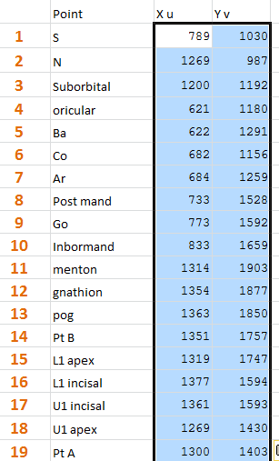
Step 7
The coordinate will be transfer to excel

Slide 13
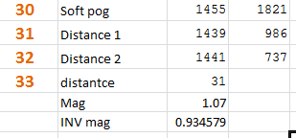
Step 8
Enter the real distance you use as reference on point 33
Magnification : the norm of Mahidol analysis have been calculated with a magnification of 7%
So by default this value is 1.07 if you want to use Mahidol norm for a Thai patient DON’T TOUCH IT
If your patient is not Thai ask your Professor for advice
This is important only for measurement in MM for the angle it does not make any difference

Slide 14
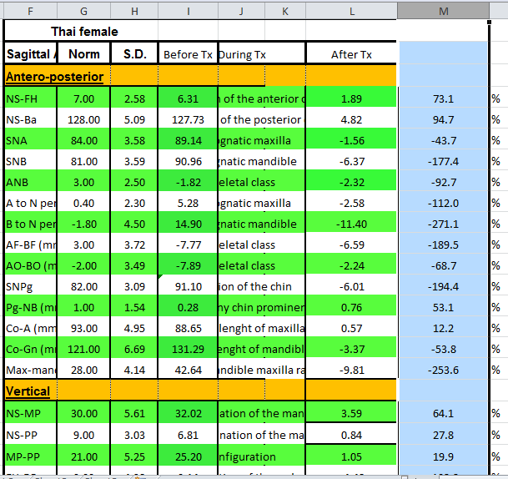
Step 8
THE EXCEL SHEET
This column give you the variation to the norm in percentage
100 to 25% the patient is normal
25 to 0 % the patient is Tendency ( Tendency prognathic, retrognatic, open , close configuration …)
The value is negative the patient is outside the norm, the more important the value the more the patient is outside the norm

Slide 15
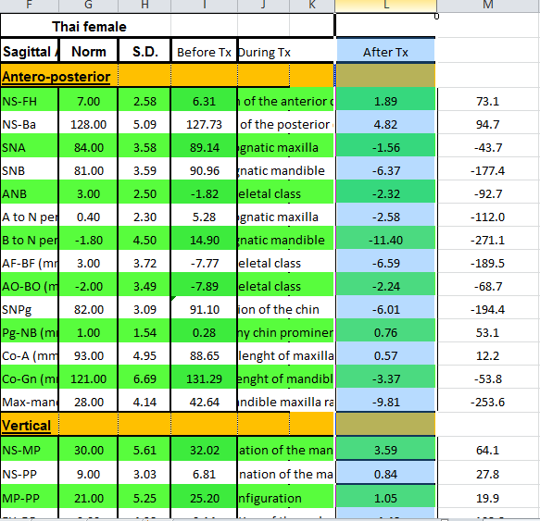
Step 8
This column give you the variation to the norm in Degree and millimeter
The value is positive the patient is inside the norm
The value is negative the patient is outside the norm and you know by how many degree or millimeter
For the value in millimeter there is automatic correction of the magnification, in this example the patient mandible length is 3.37 mm to longue.

Slide 16
Step 9
The PA
You do exactly the same
IF YOU SEE ANY MISTAKE PLEASE LET ME KNOW

Slide 17
Step 10
MOTIVATE TOTO TO ADD AUTOMATIC COLORING DEPENDING ON THE RESULTS

